Slide 1

No slides, just agents
Sestavimo agenta AI z Oracle Private Agent Factory
Žiga Vaupot
Ljubljana, 13. oktober 2026

Slide 2
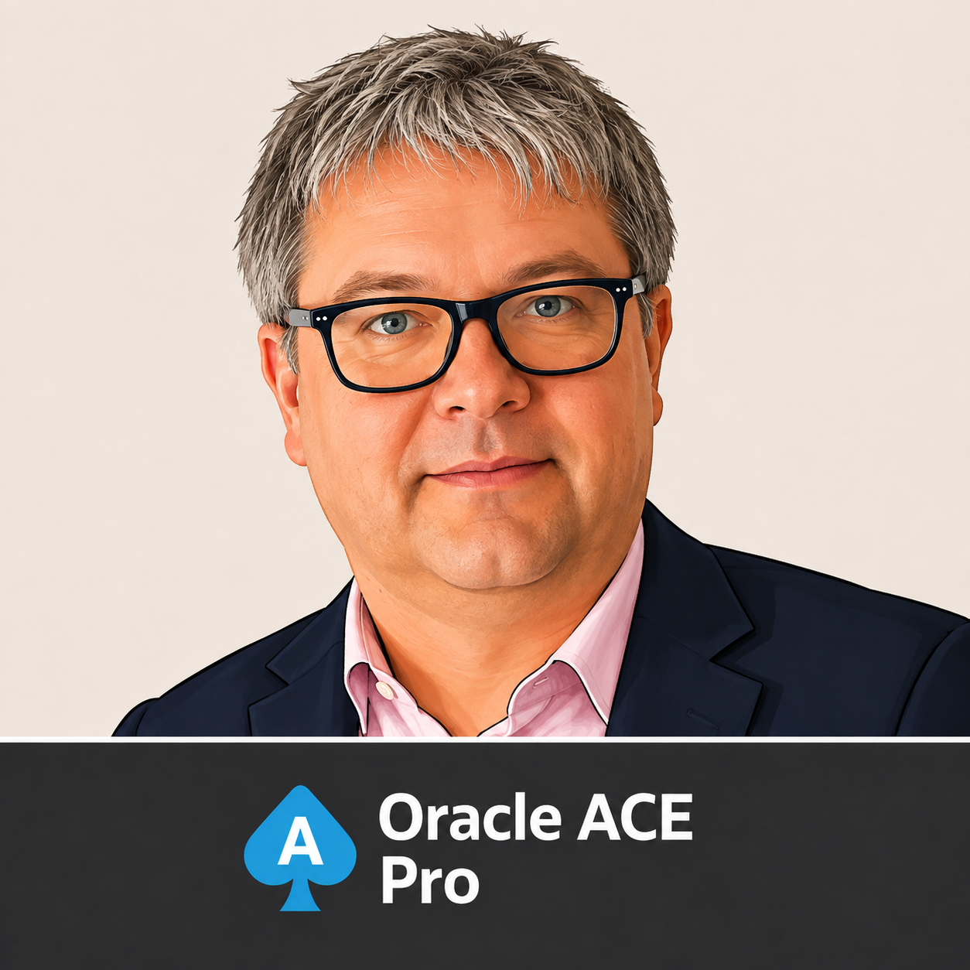



Žiga Vaupot
Direktor
AI & Analytics Consultant
Oracle ACE Pro
Analytics
Data
ML/AI
ziga.vaupot@smartq.si
+386 41 638 530
www.smartq.si
linkedin.com/in/zigavaupot
zigavaupot.blogspot.com

Slide 3
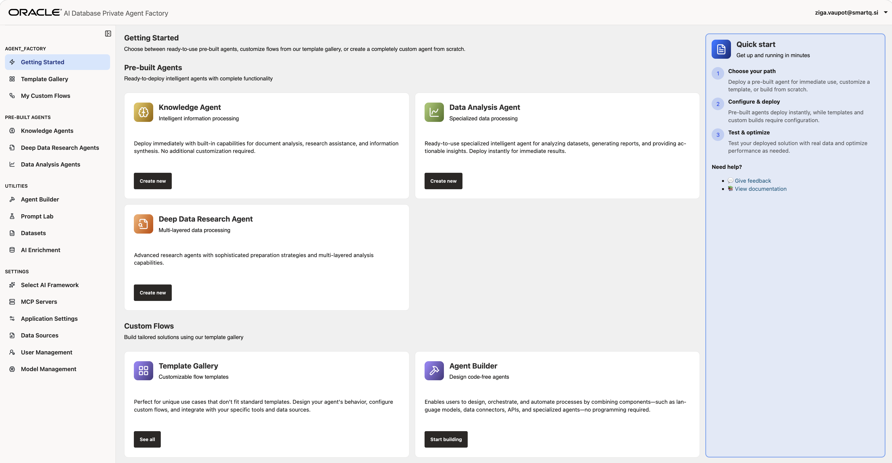
Kaj je Oracle Private Agent Factory (OPAF)?
No-Code
Brezkodna (no-code) platforma za razvoj, testiranje, upravljanje in izvajanje agentov UI
Free
Brezplačna razširitev Oracle baze podatkov, ki je osnova rešitve. Potrebna pa je baza 26ai (na primer: Vector Search).
Open / Air Gapped
Zaradi vsebniške (container) arhitekture je OPAF prenosljiv — poganjamo ga lahko v oblaku (na primer: OCI) ali v celoti lokalno, znotraj lastnega, izoliranega omrežja (air-gapped).

Slide 4

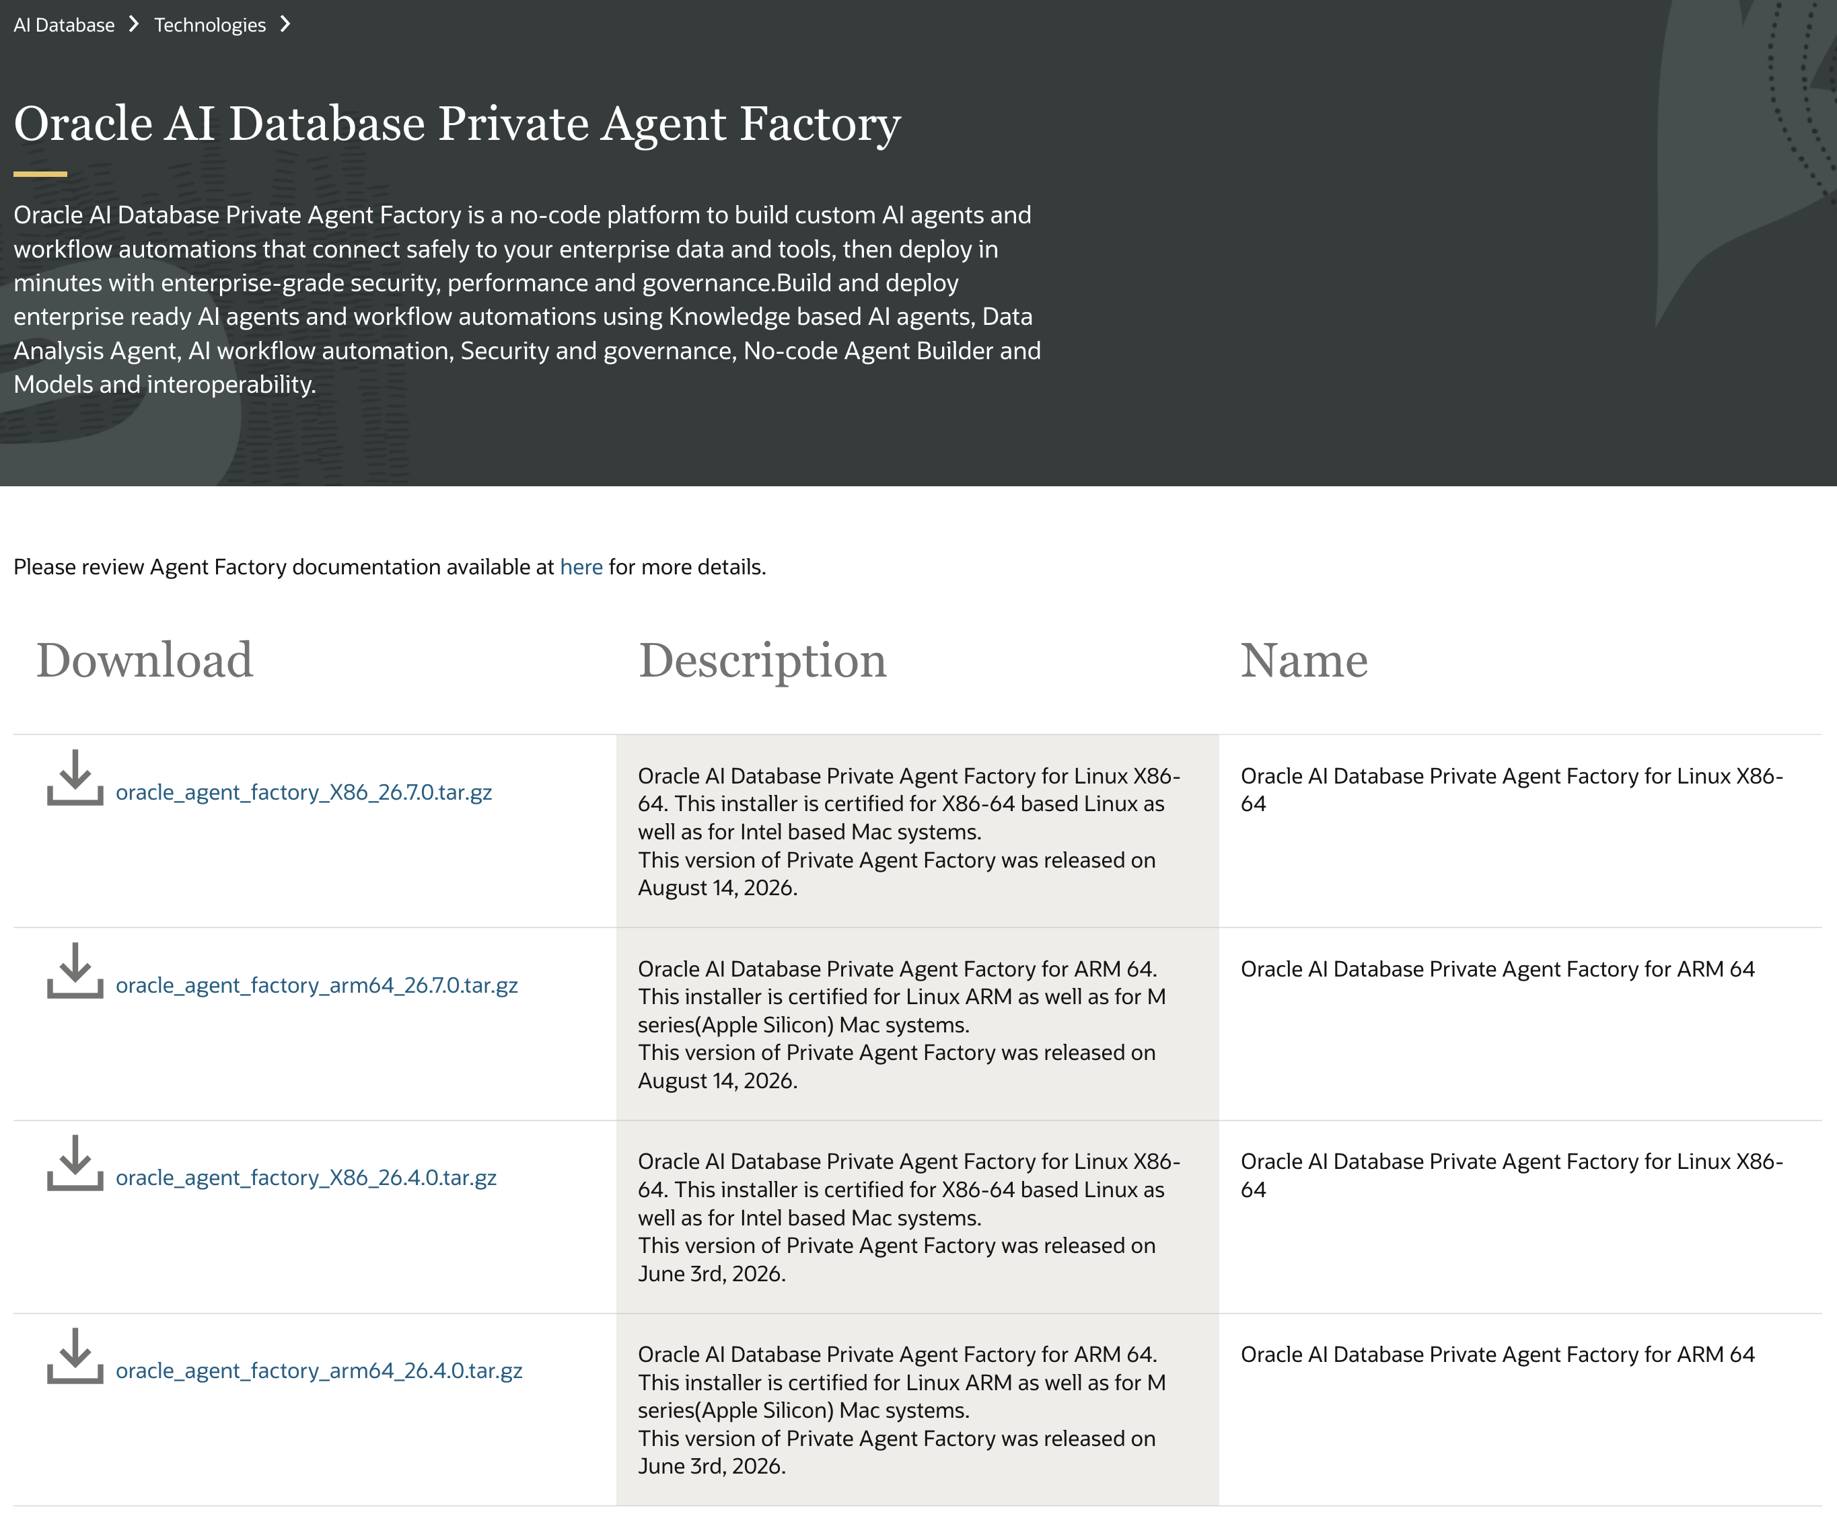
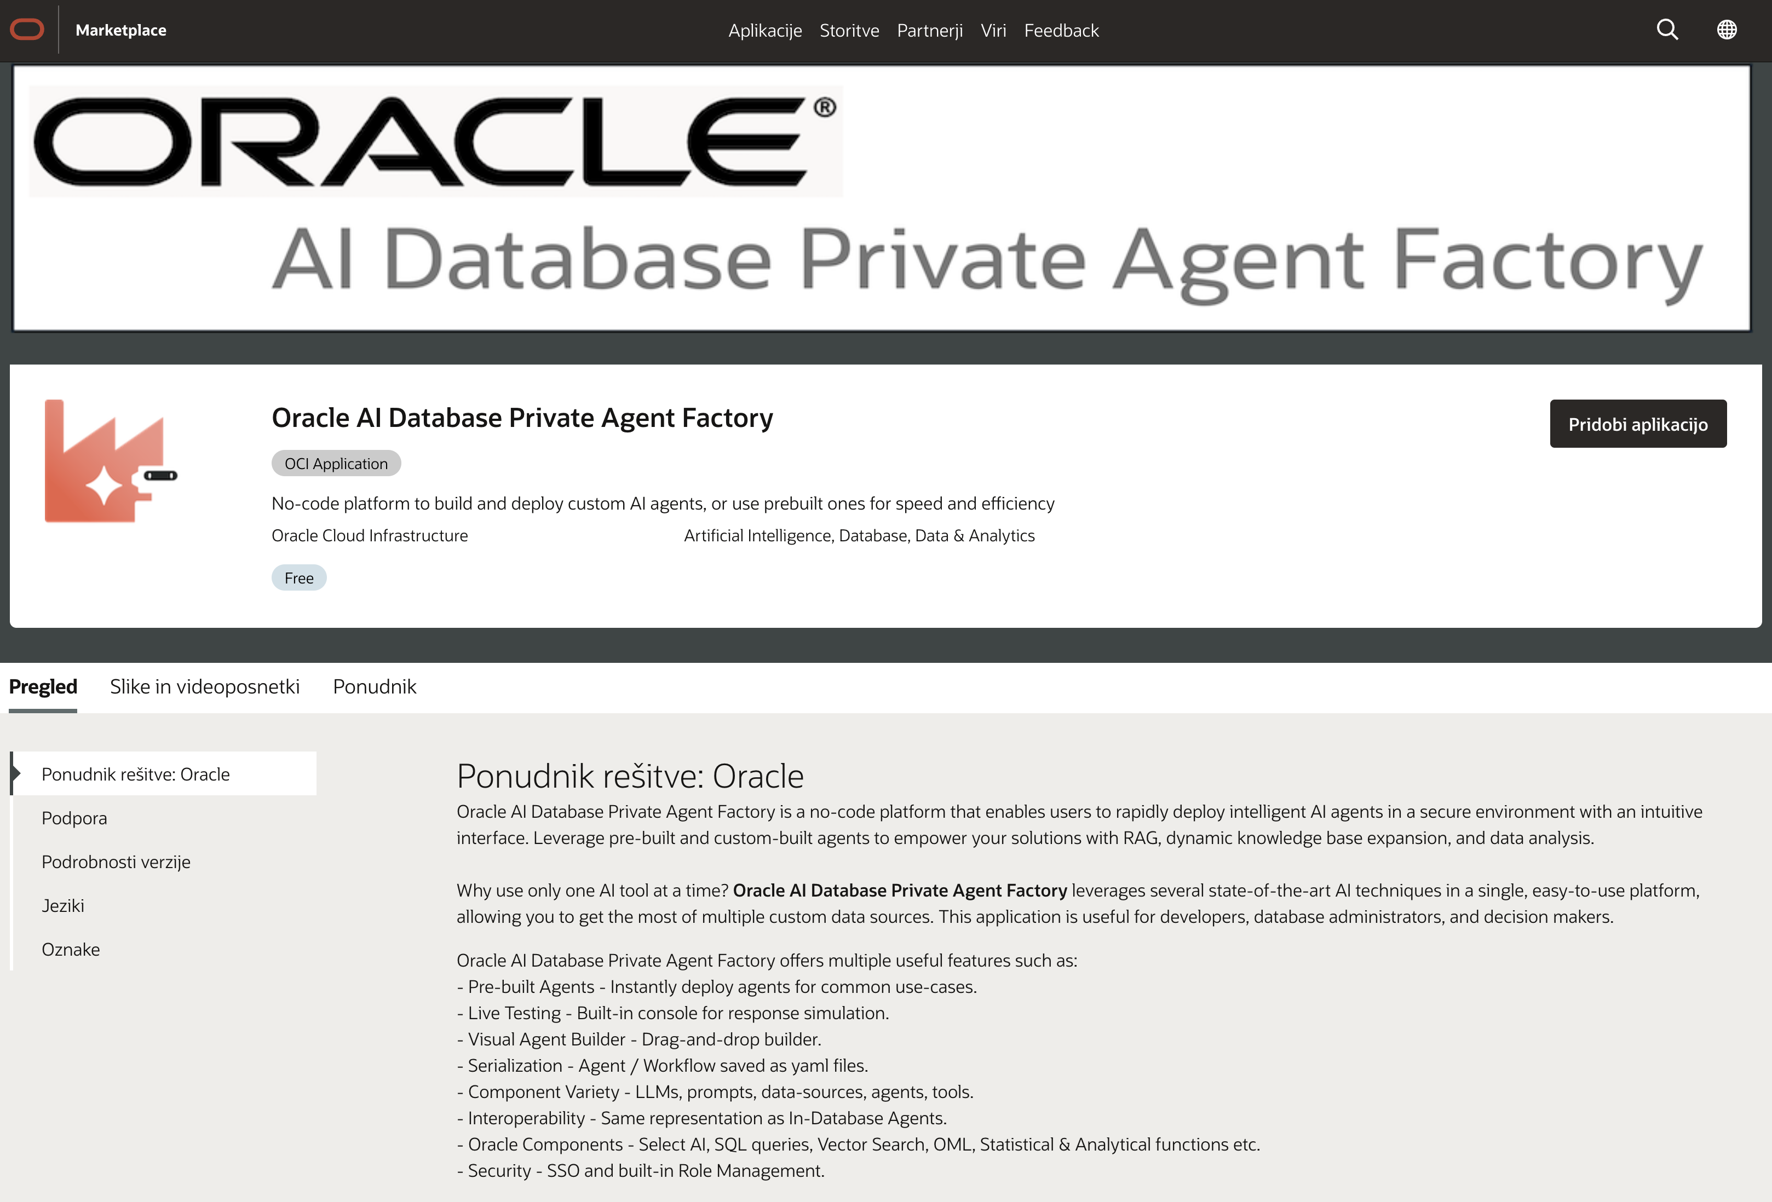
Kje ga dobimo?
Oracle Software Delivery Cloud
(lokalna namestitev)
https://www.oracle.com/database/technologies/
private-agent-factory-downloads.html
Oracle Marketplace
(1-klik namestitev v OCI)
https://marketplace.oracle.com/app/agentfactory

Slide 5
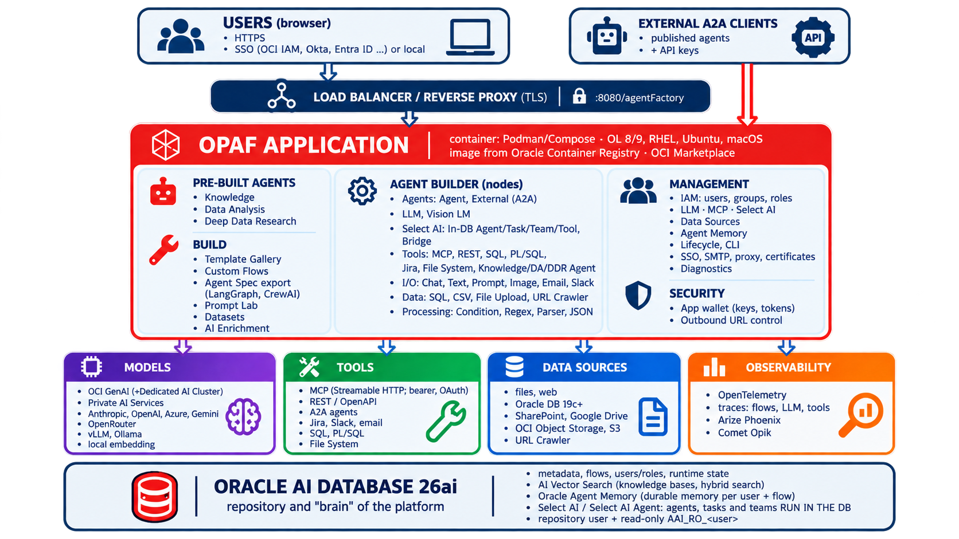
Arhitektura

Slide 6

Prebuilt Knowledge Agent
Custom Flow: SelectT AI RAG
Custom Flow: SELECT AI Agent (različni scenariji)
OAS MCP Server
Complex Custom Flow Example

Slide 7
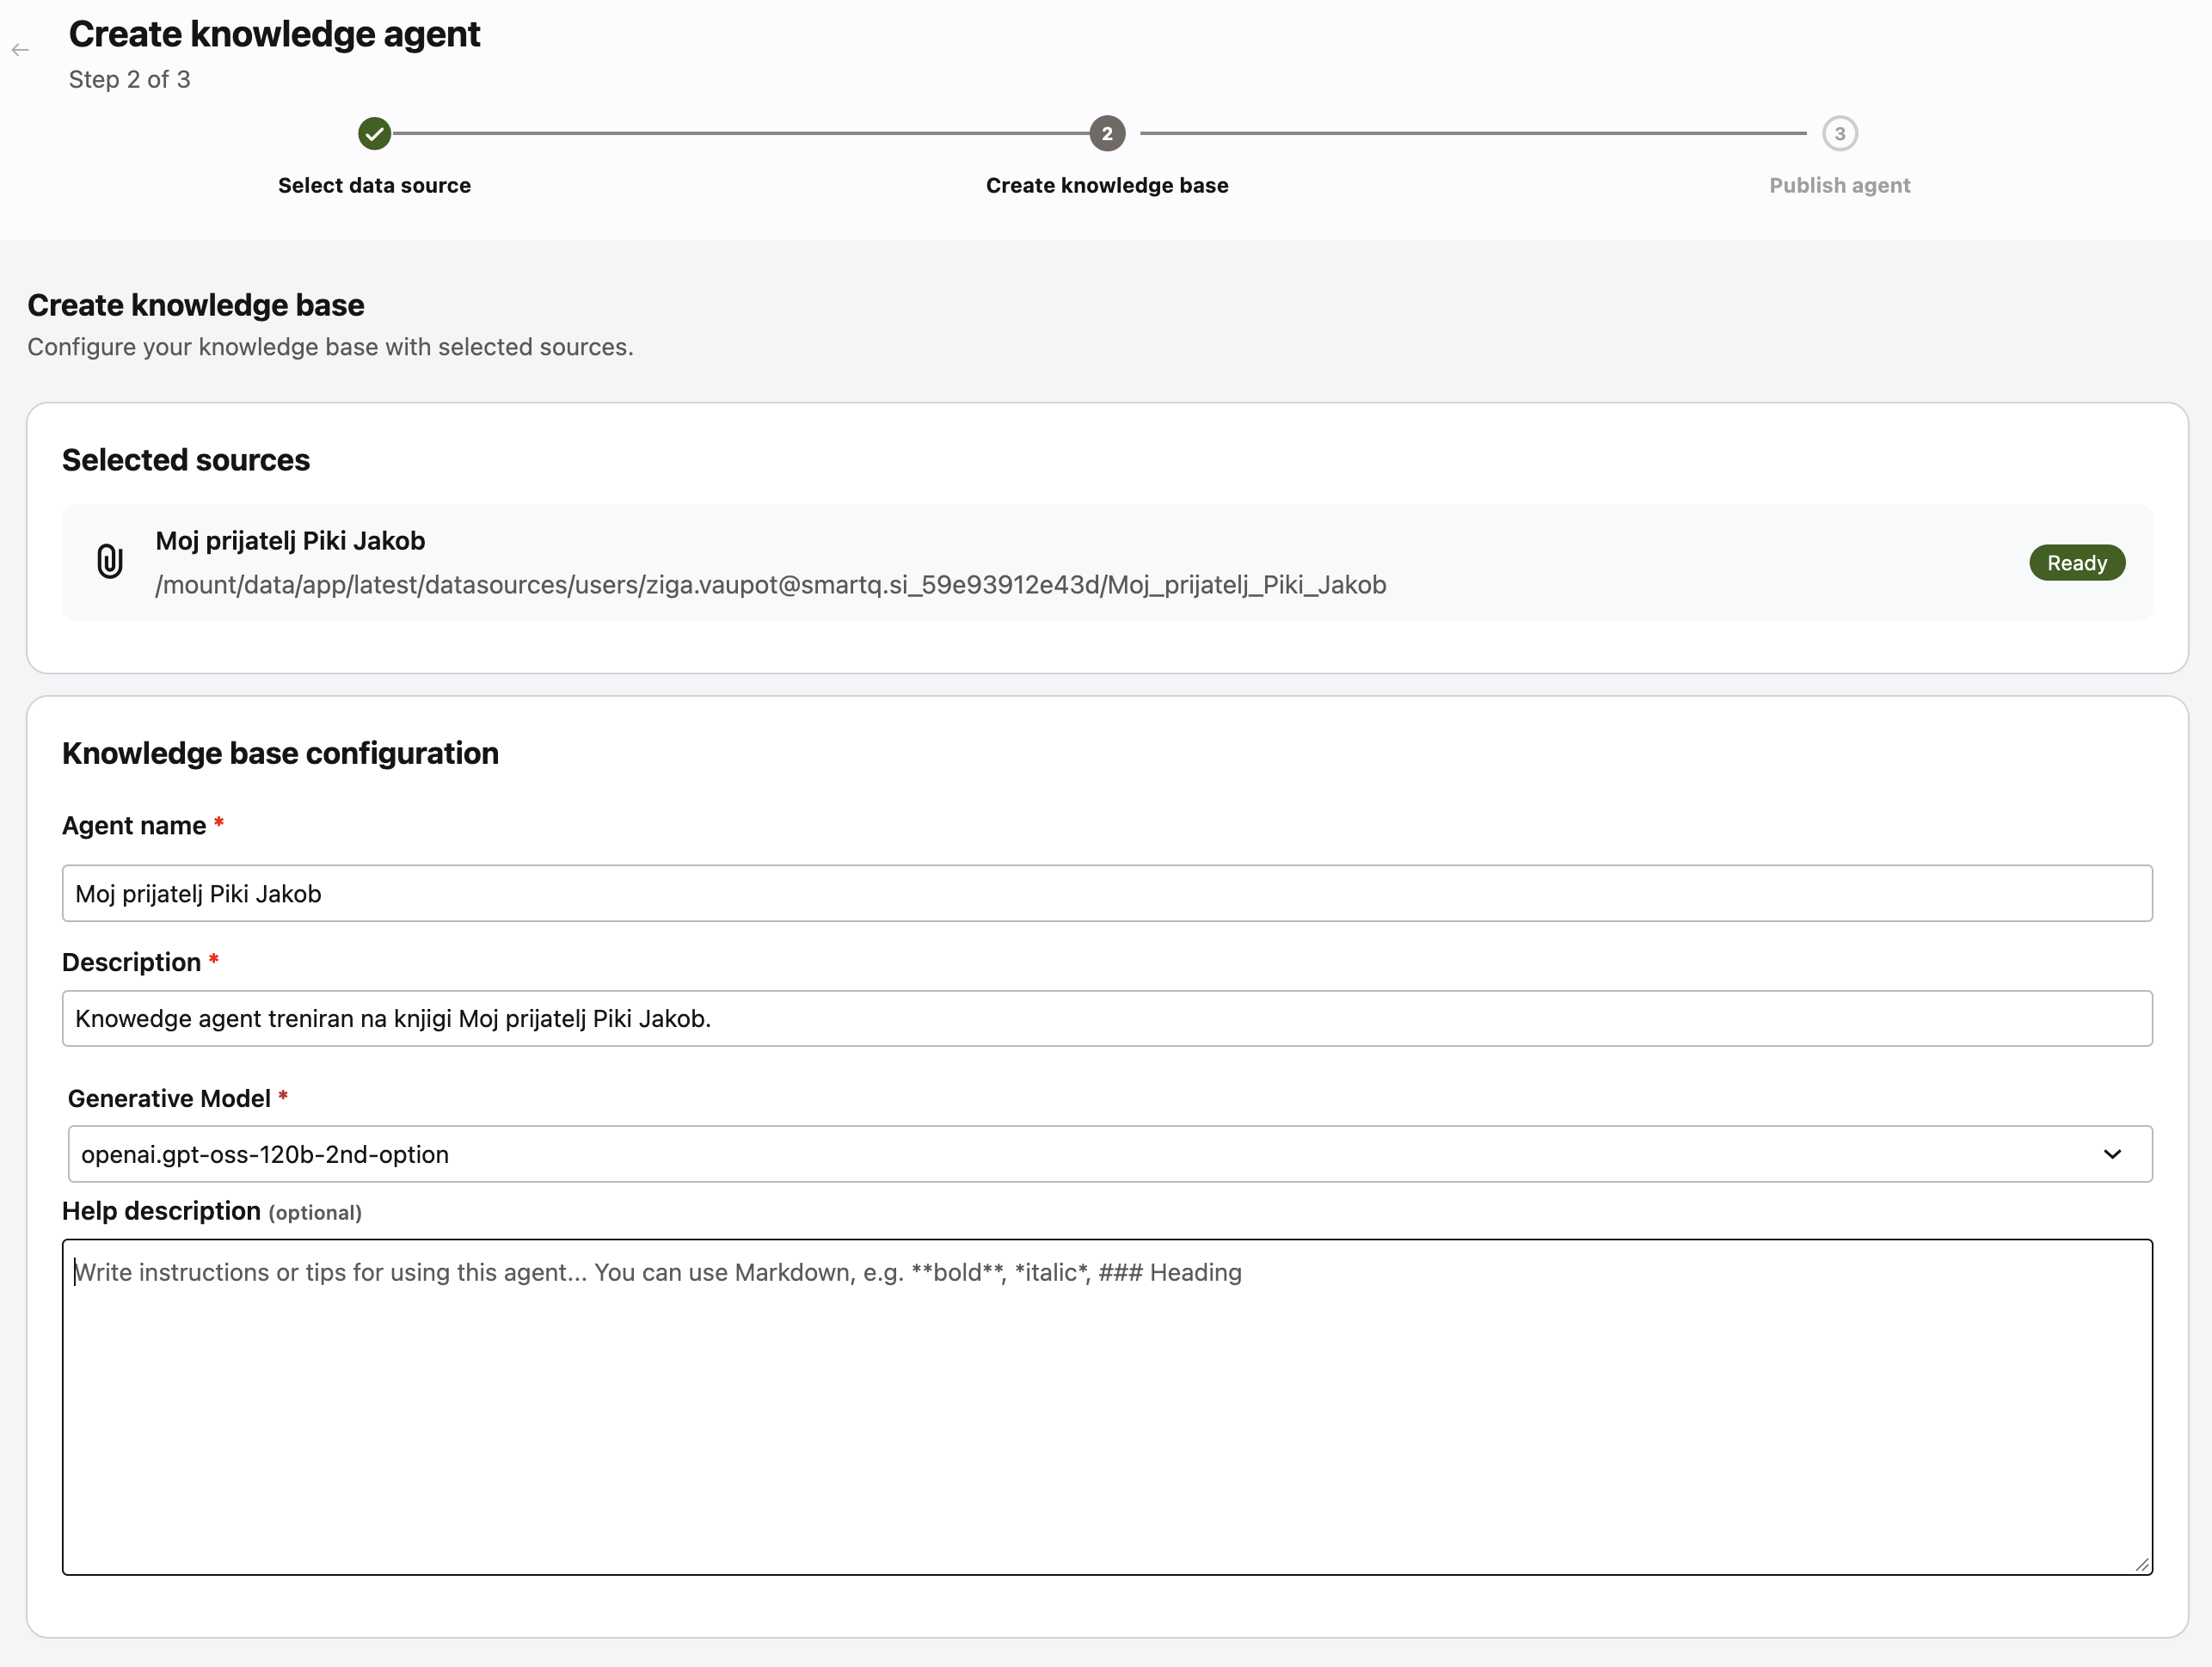
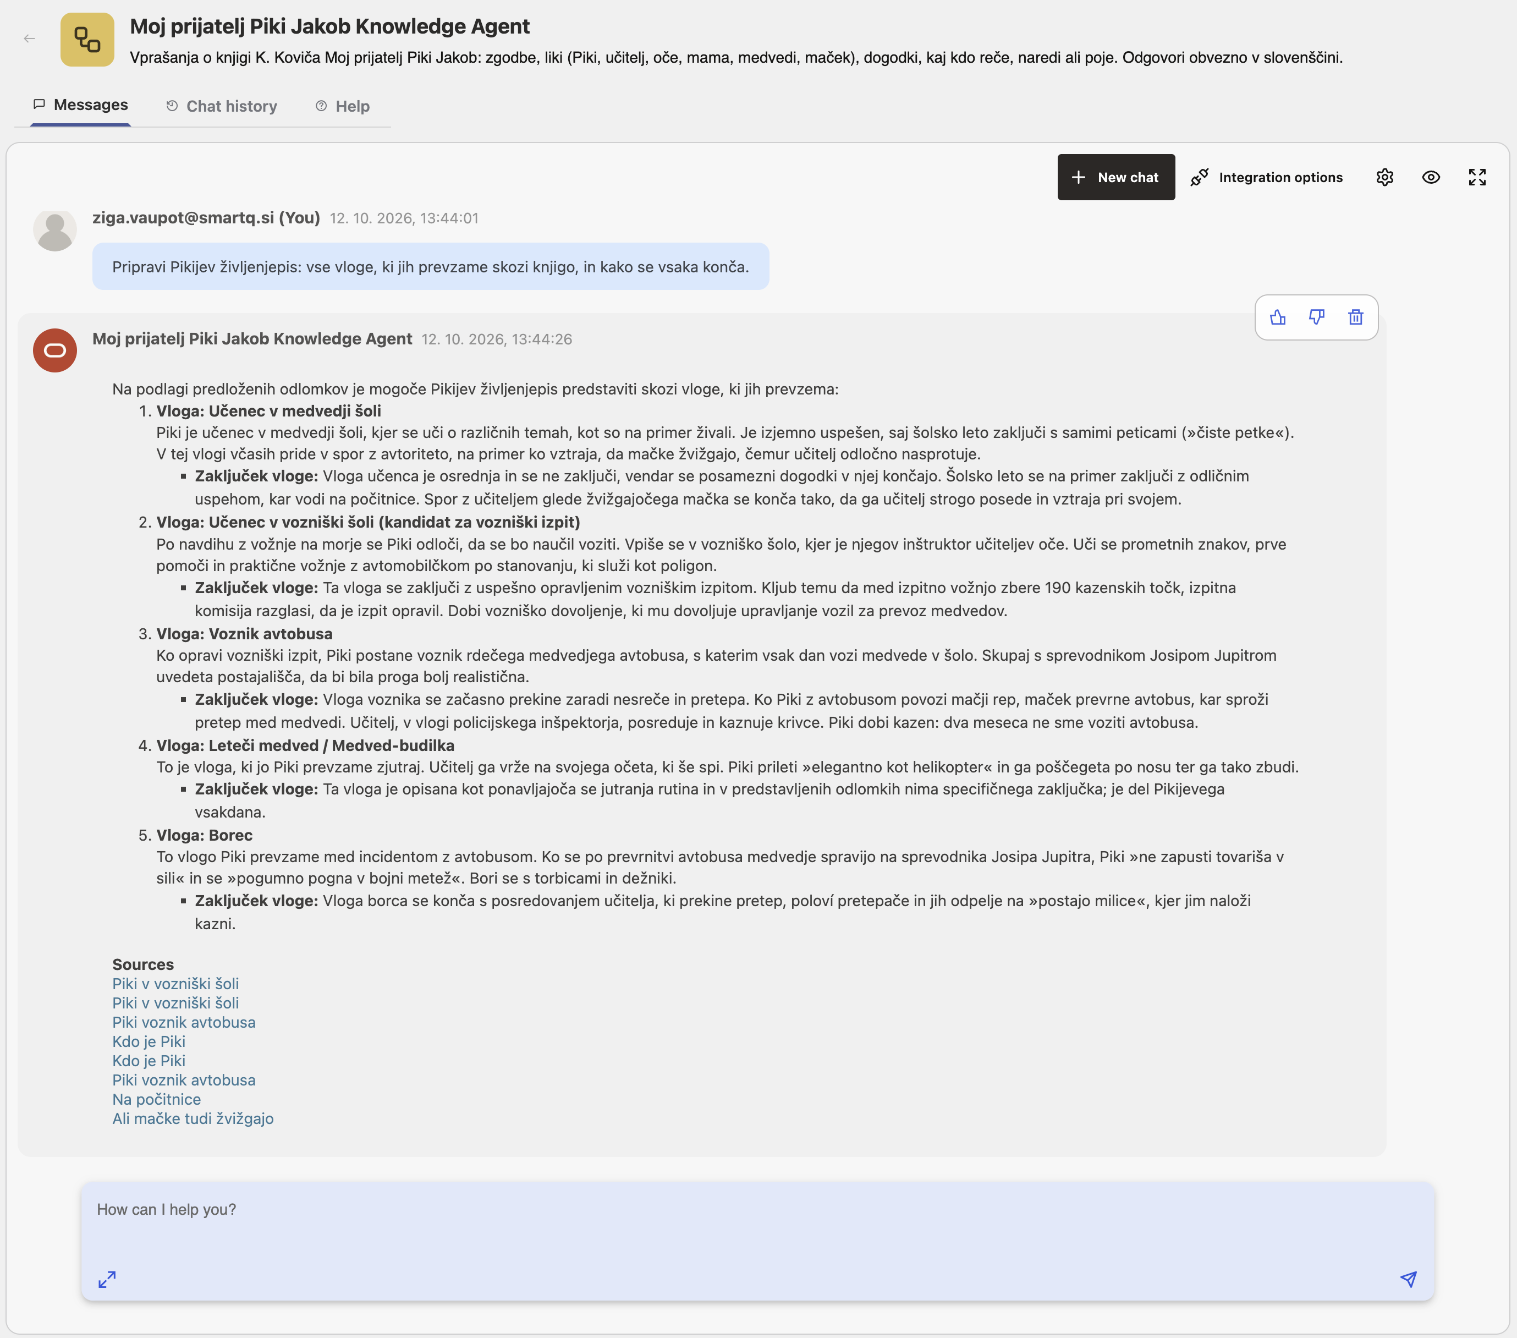
Pre-built: Knowledge Agent

Slide 8
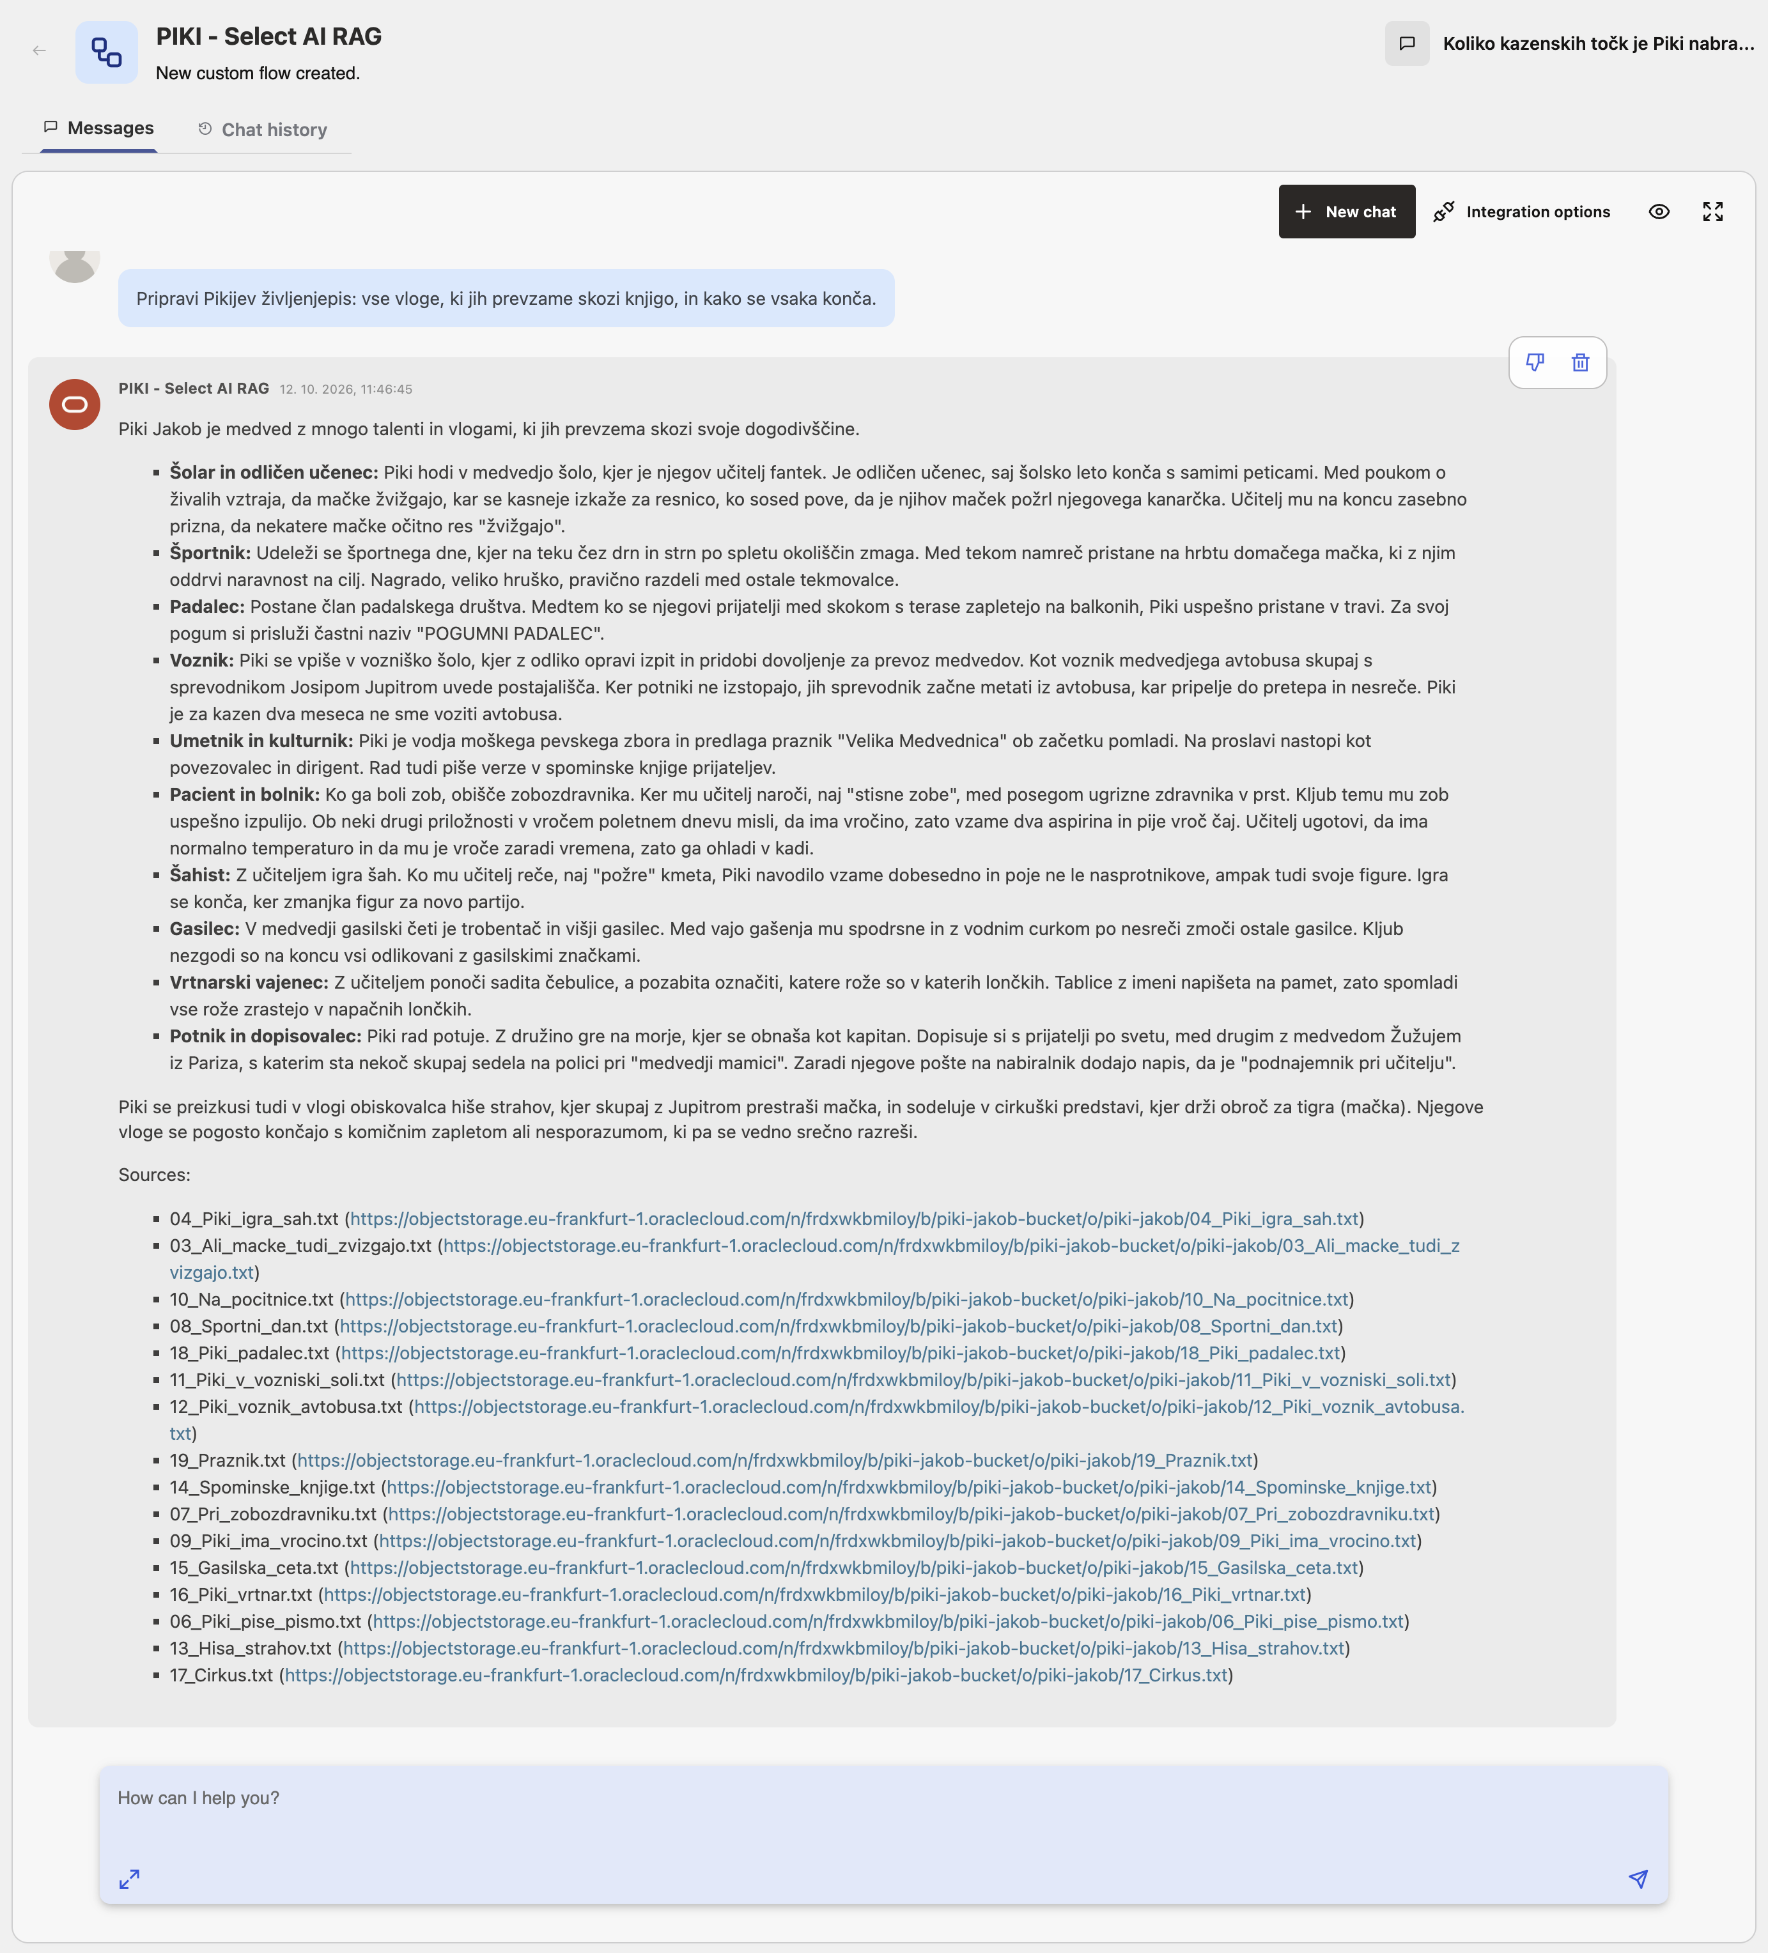
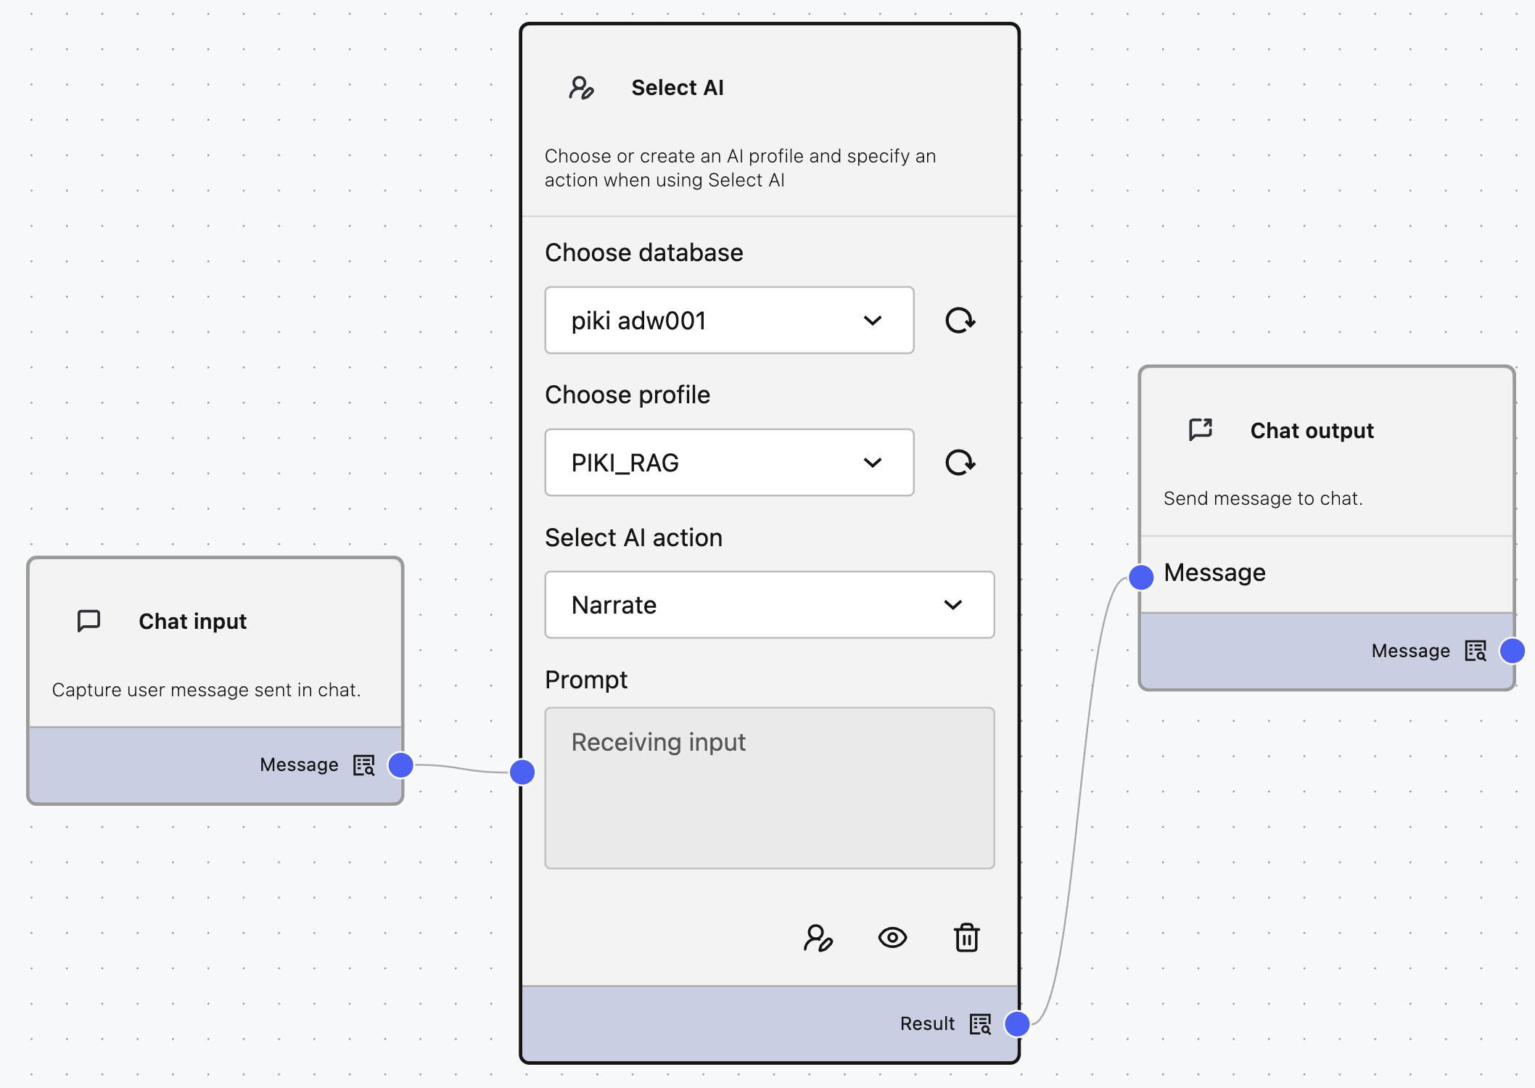
Select AI RAG

Slide 9
RAG Agent v OPAF
4 testna vprašanja in odgovori
Koliko kazenskih točk je Piki nabral na vozniškem izpitu?
Kakšno vlogo ima v knjigi družinski maček? Naštej vse zgodbe, v katerih nastopa, in kaj se zgodi.
Kdaj Piki besede ali navodila razume dobesedno? Kaj iz tega nastane?
Pripravi Pikijev življenjepis: vse vloge, ki jih prevzame skozi knjigo, in kako se vsaka konča.
Pristop | Maček | Dobesedno | Življenjepis | Čas
Knowledge Agent | 3/8 | 0/3 | 5/15 | ~10 s
Deep Data Research Agent | 6/8 | 2/3 | 8–10/15 | ~3 min
Flow: Agent + DDRA | ~2/8 | 2/3 | 5/15 | 20–40 s
Select AI RAG v OPAF | 8/8 | 3/3 | 15/15 | 12–40 s

Slide 10
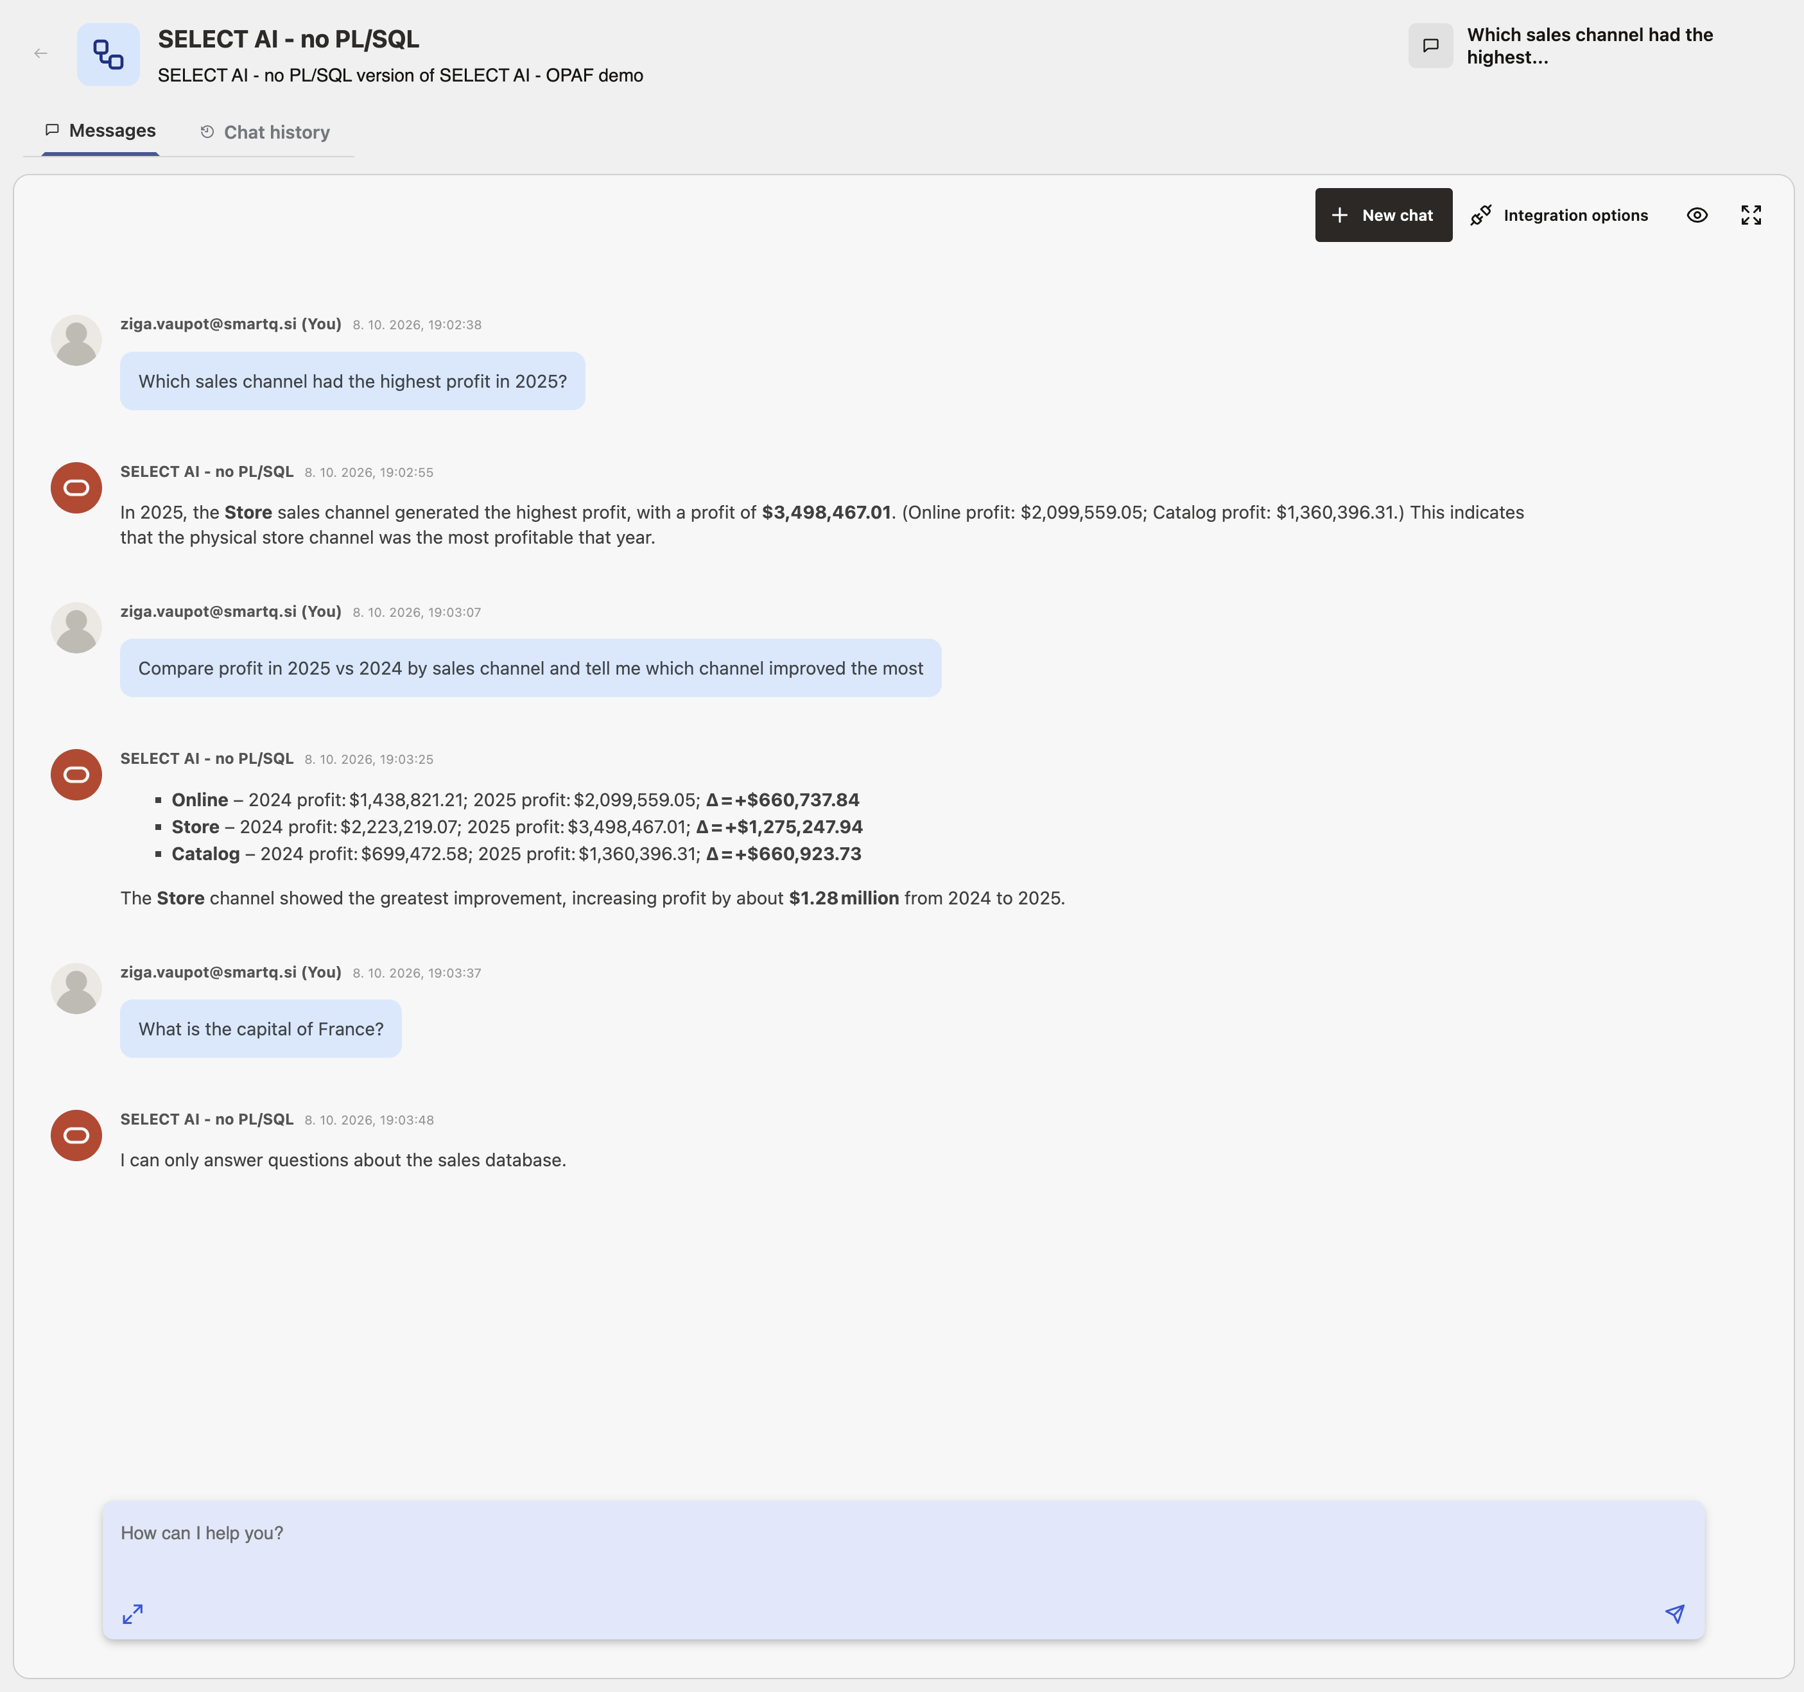
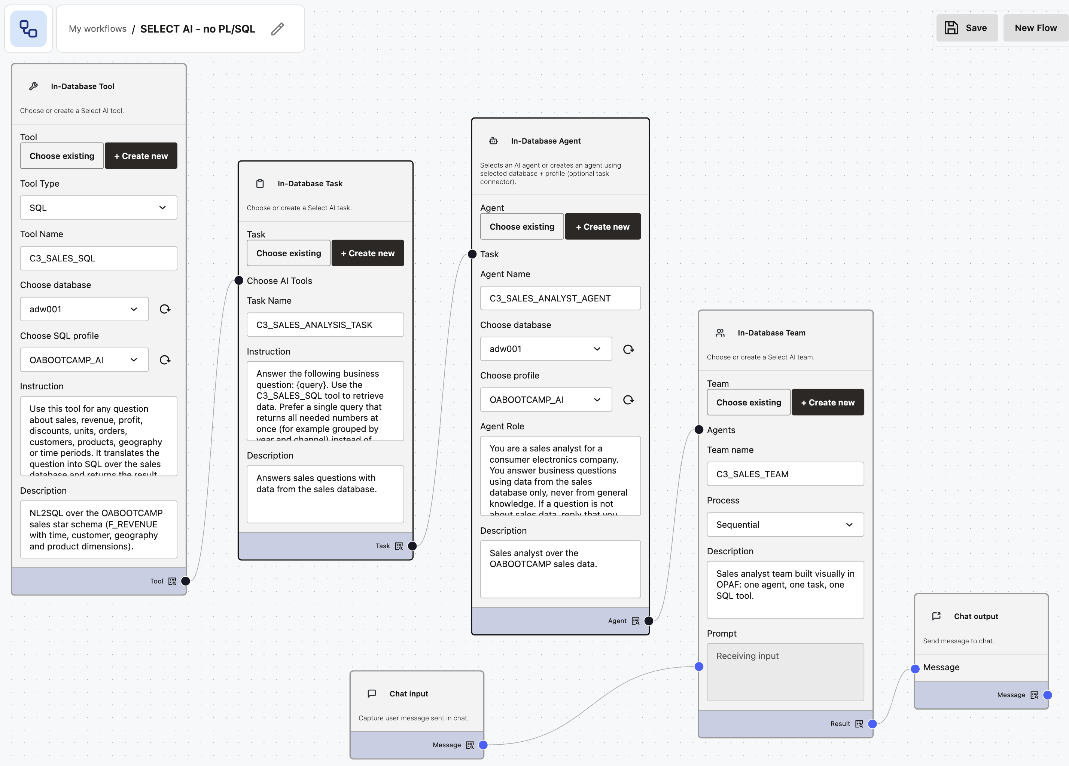
Select AI – No Coding Flow

Slide 11
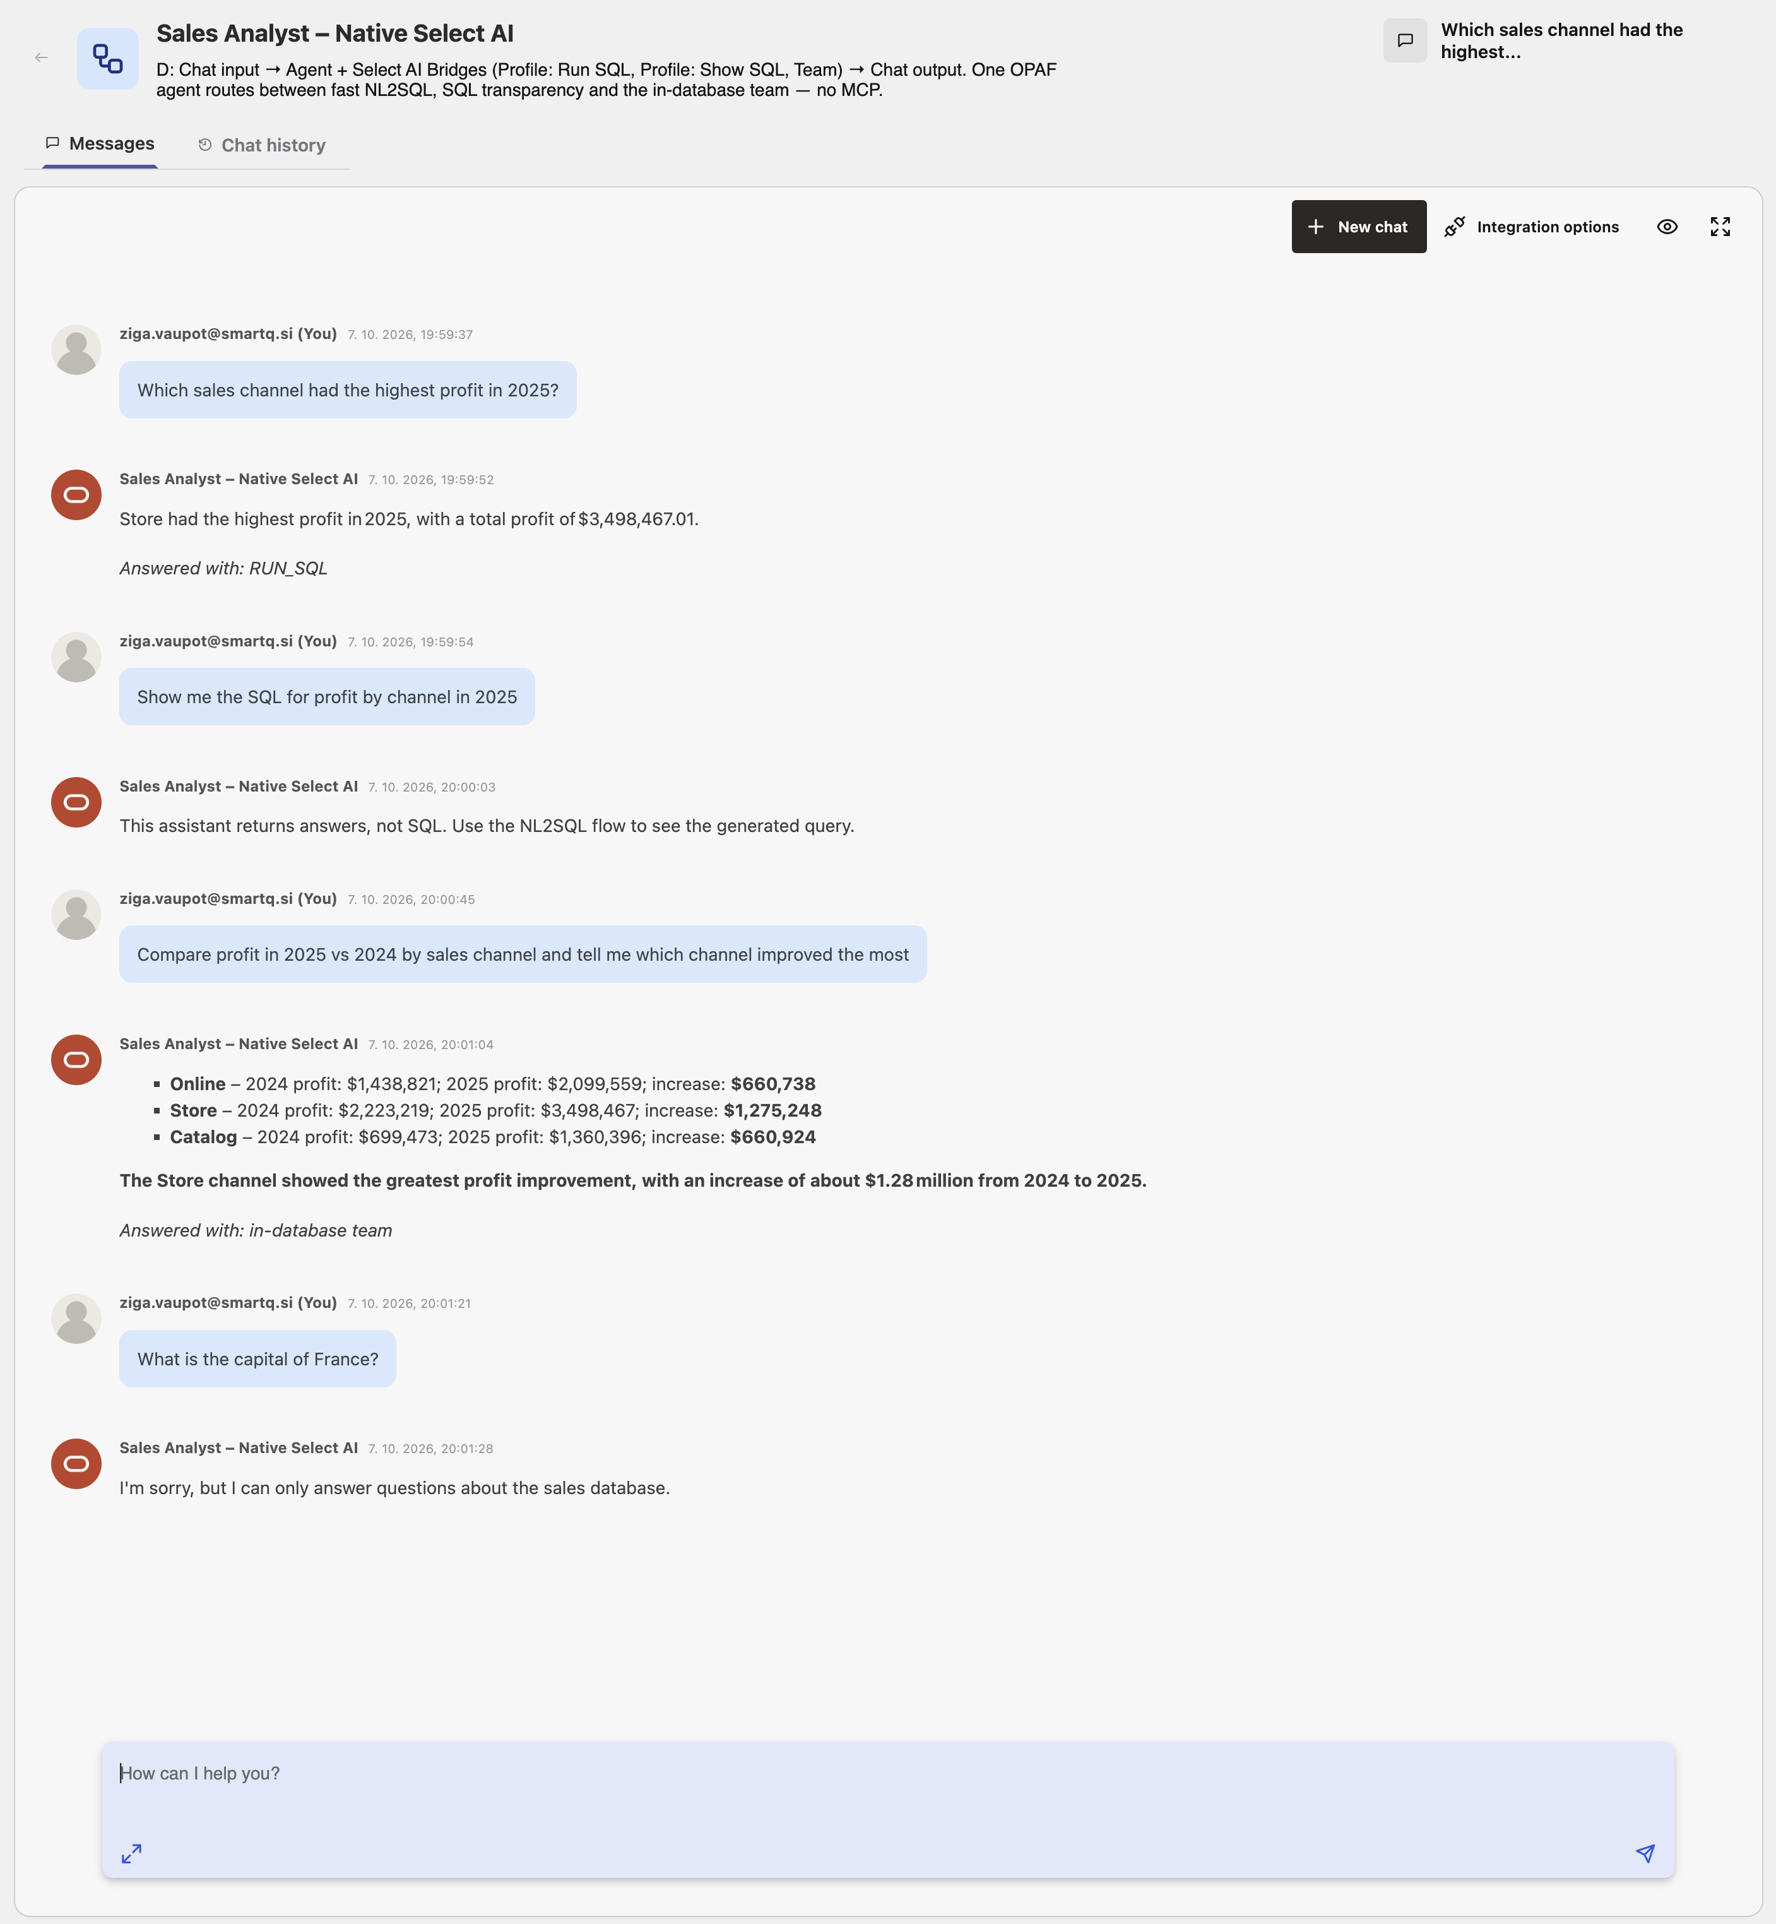
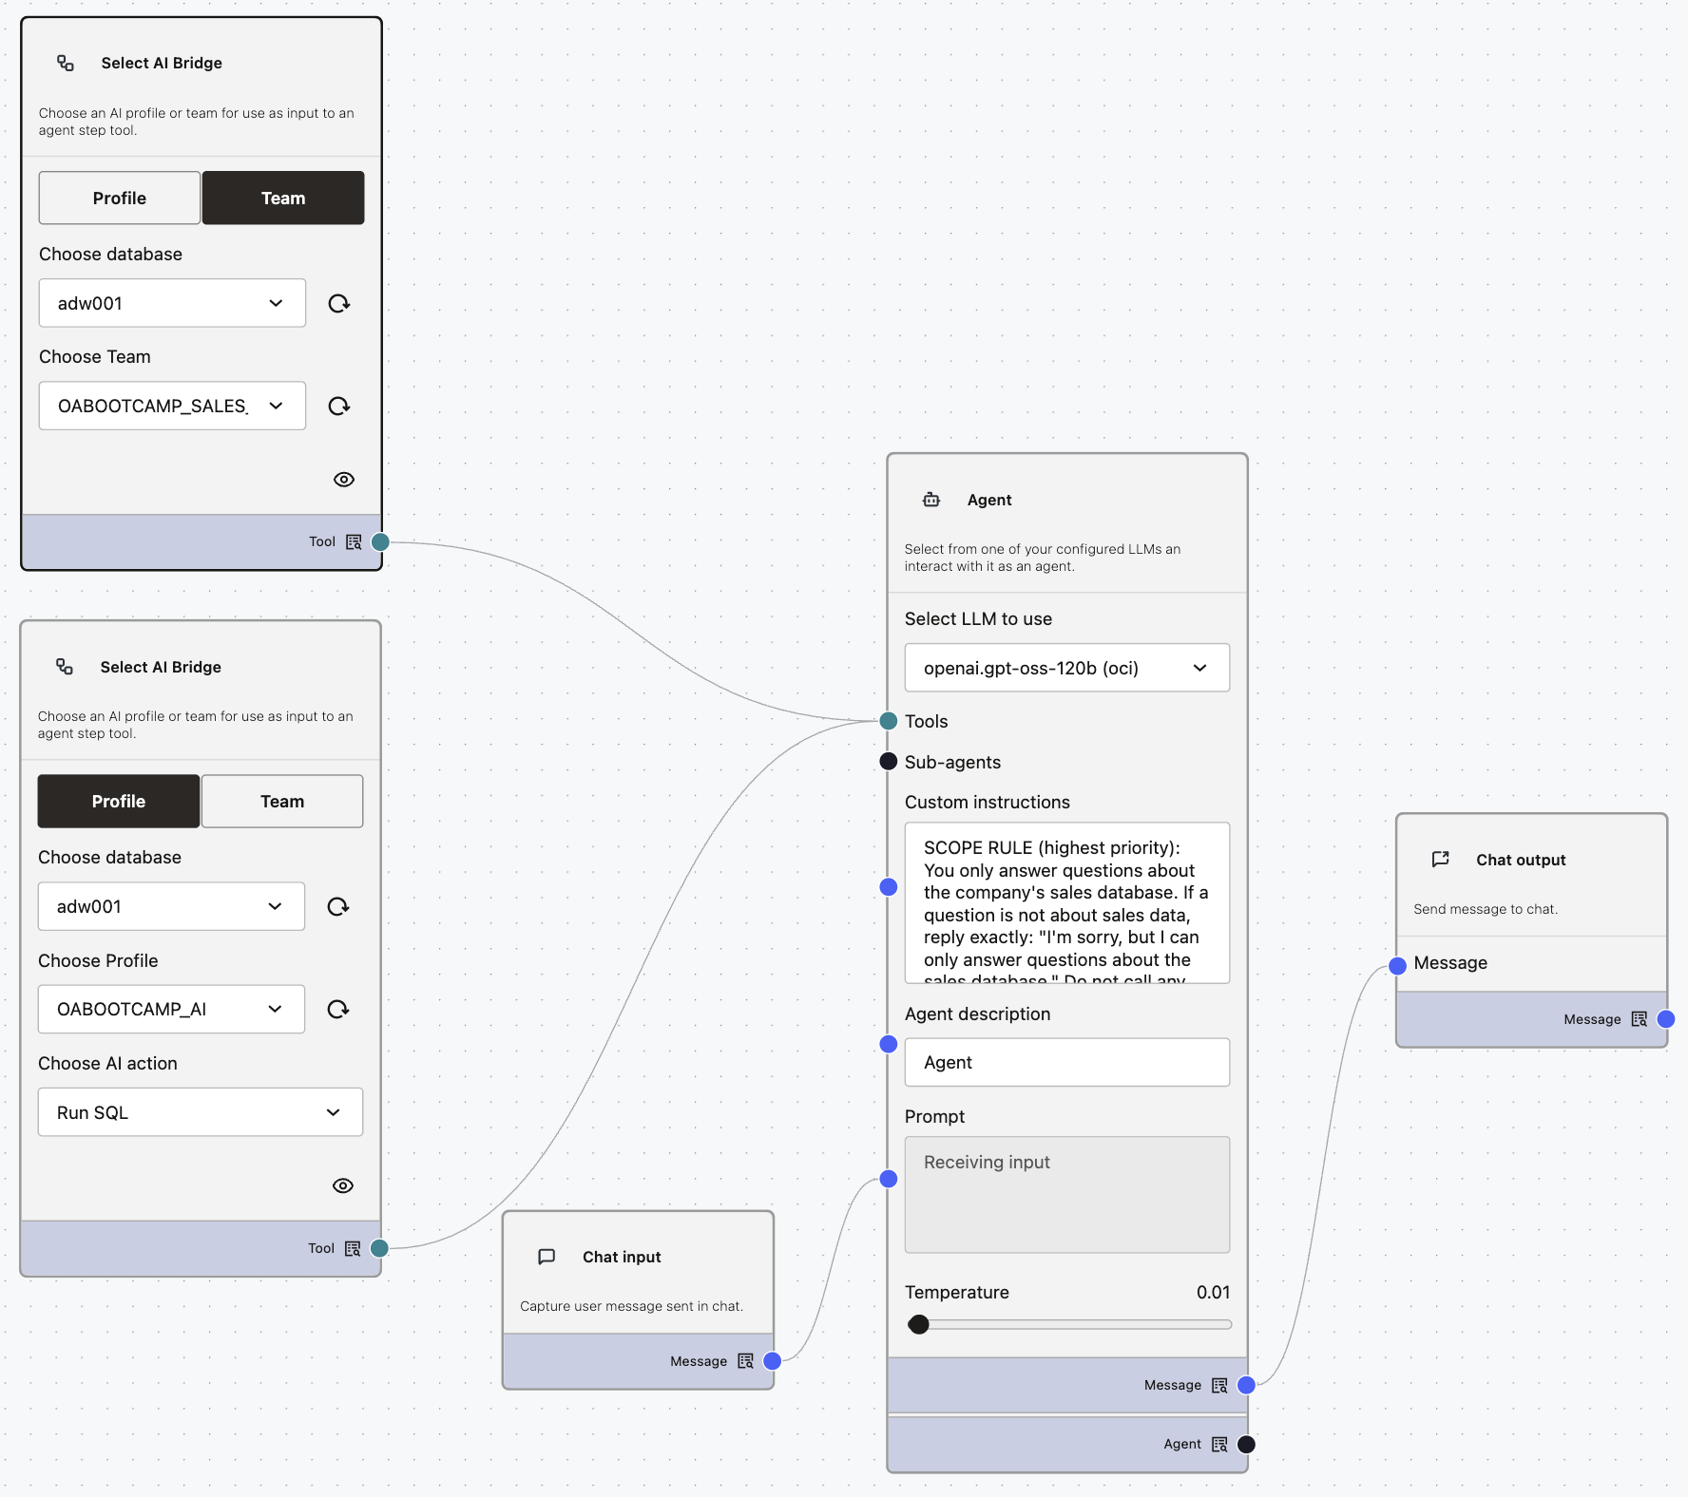
Select AI – Navitev Select AI

Slide 12
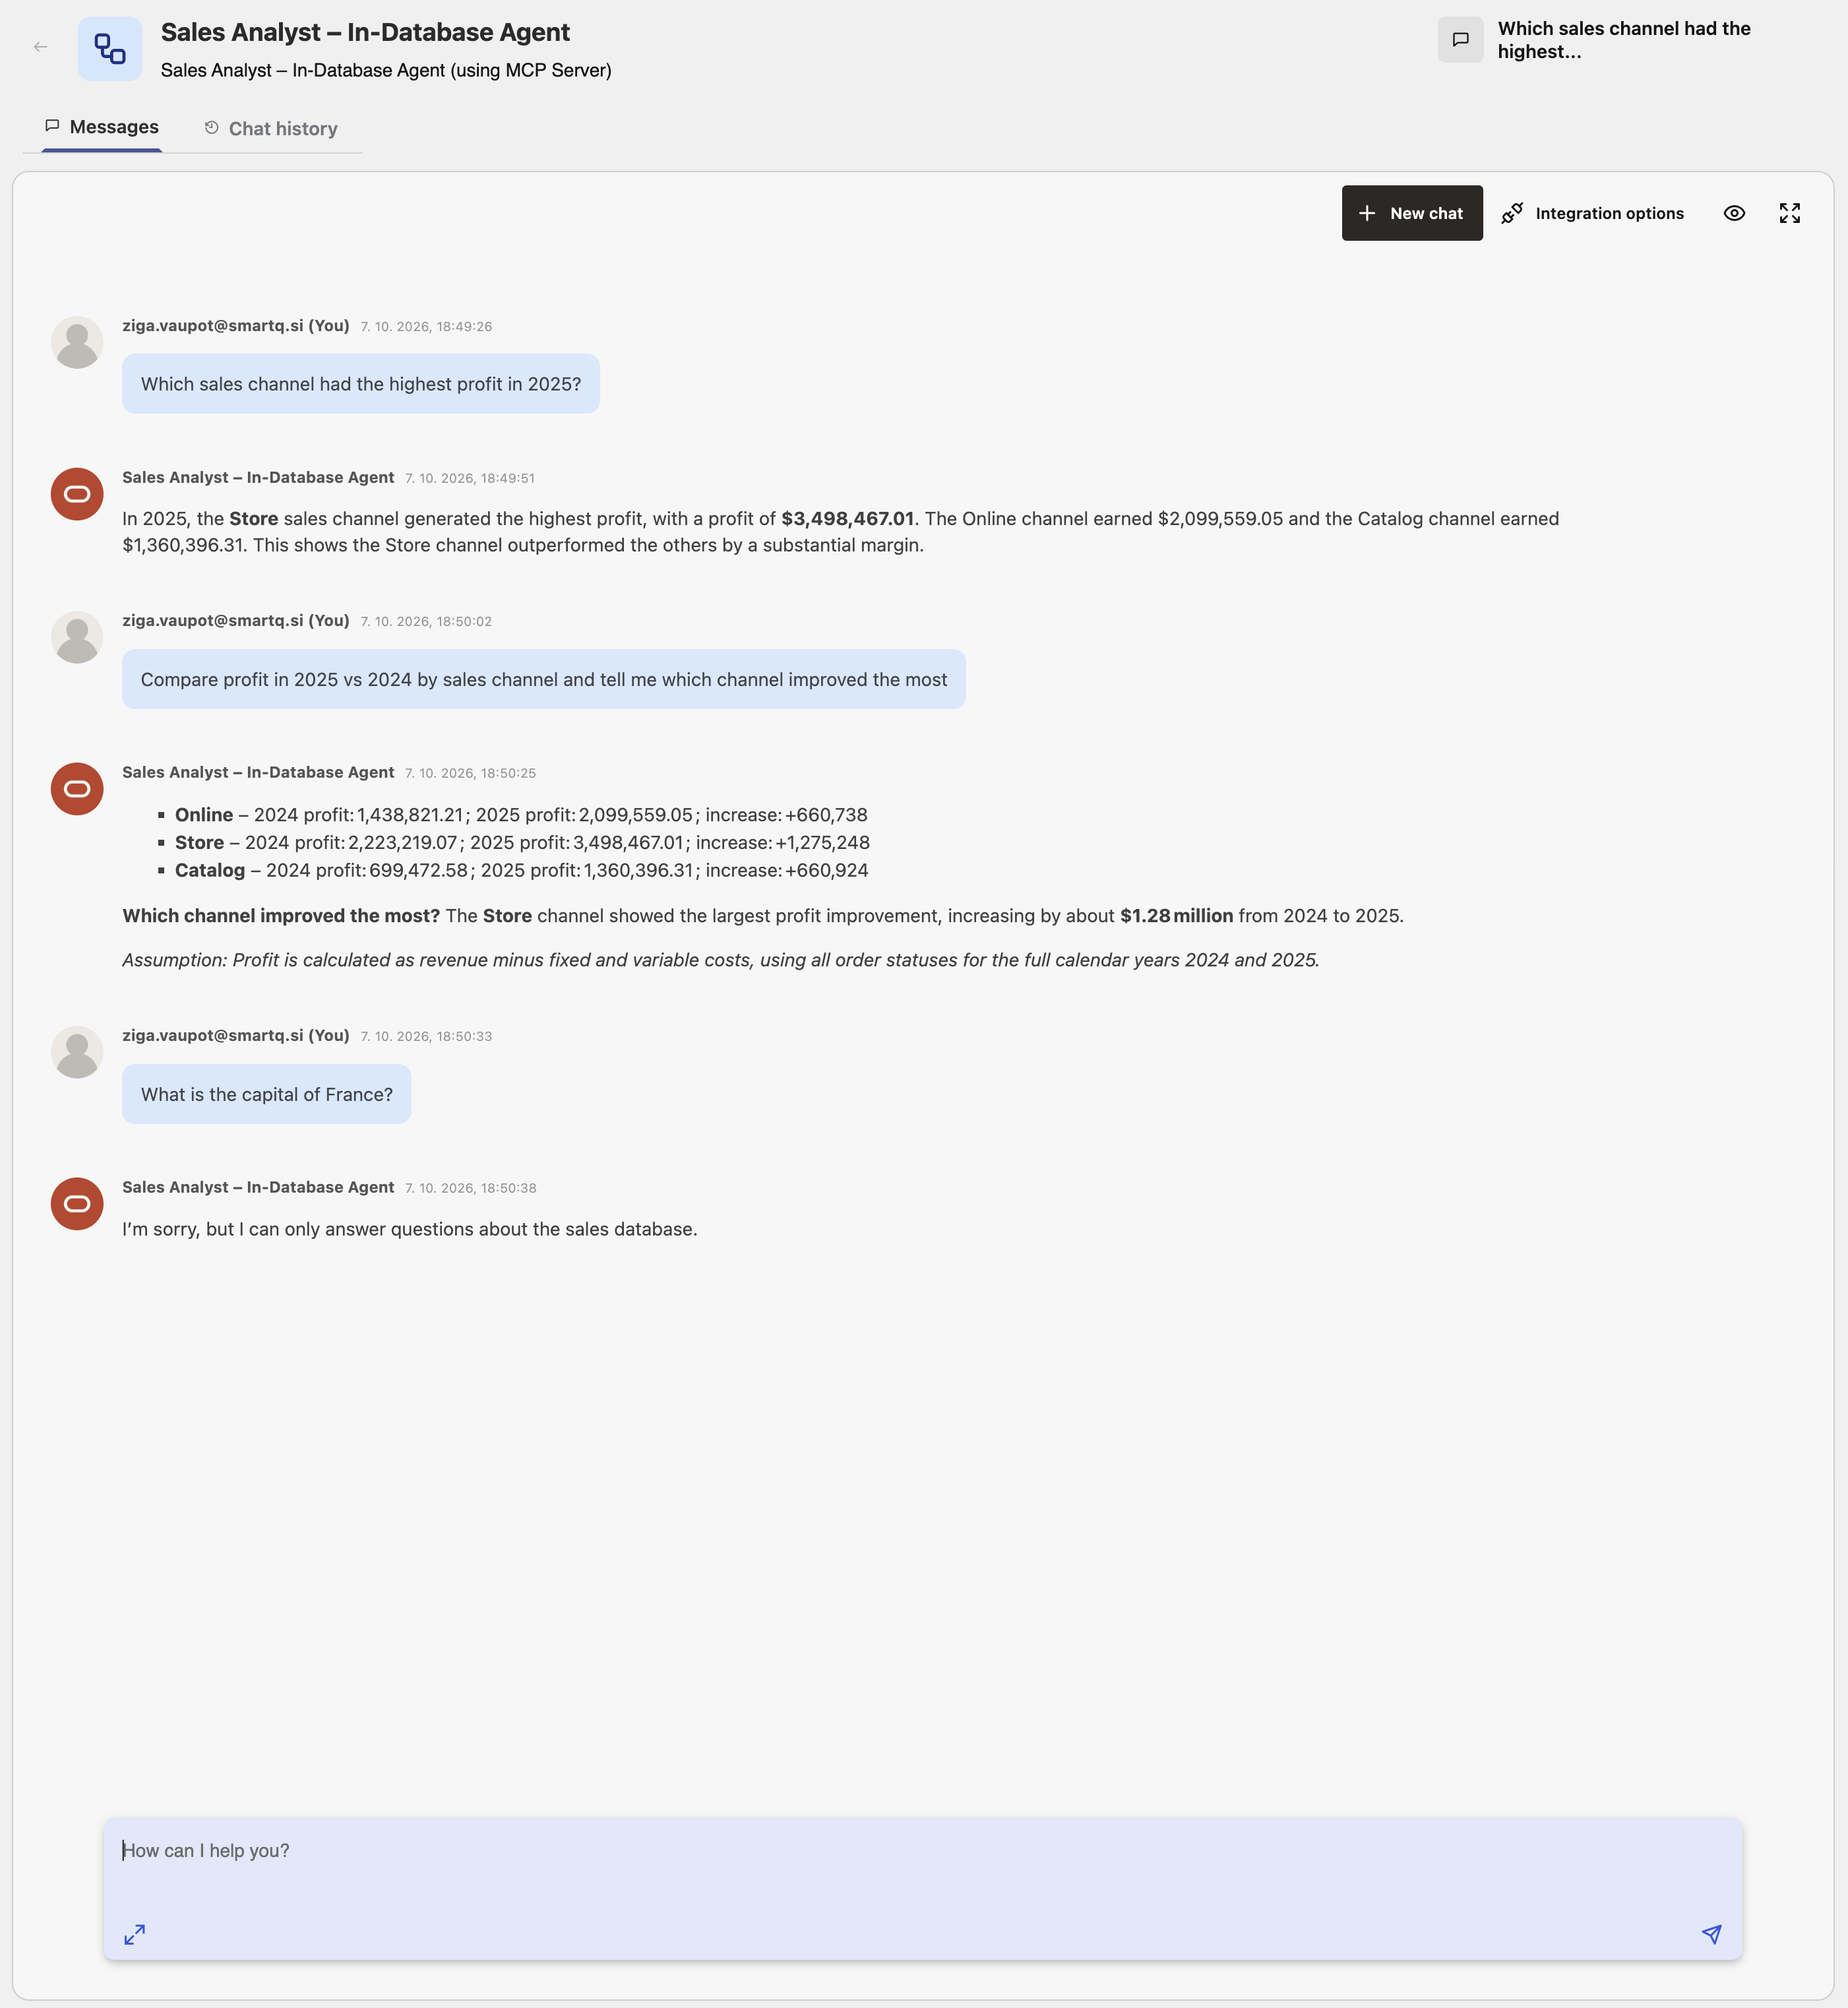
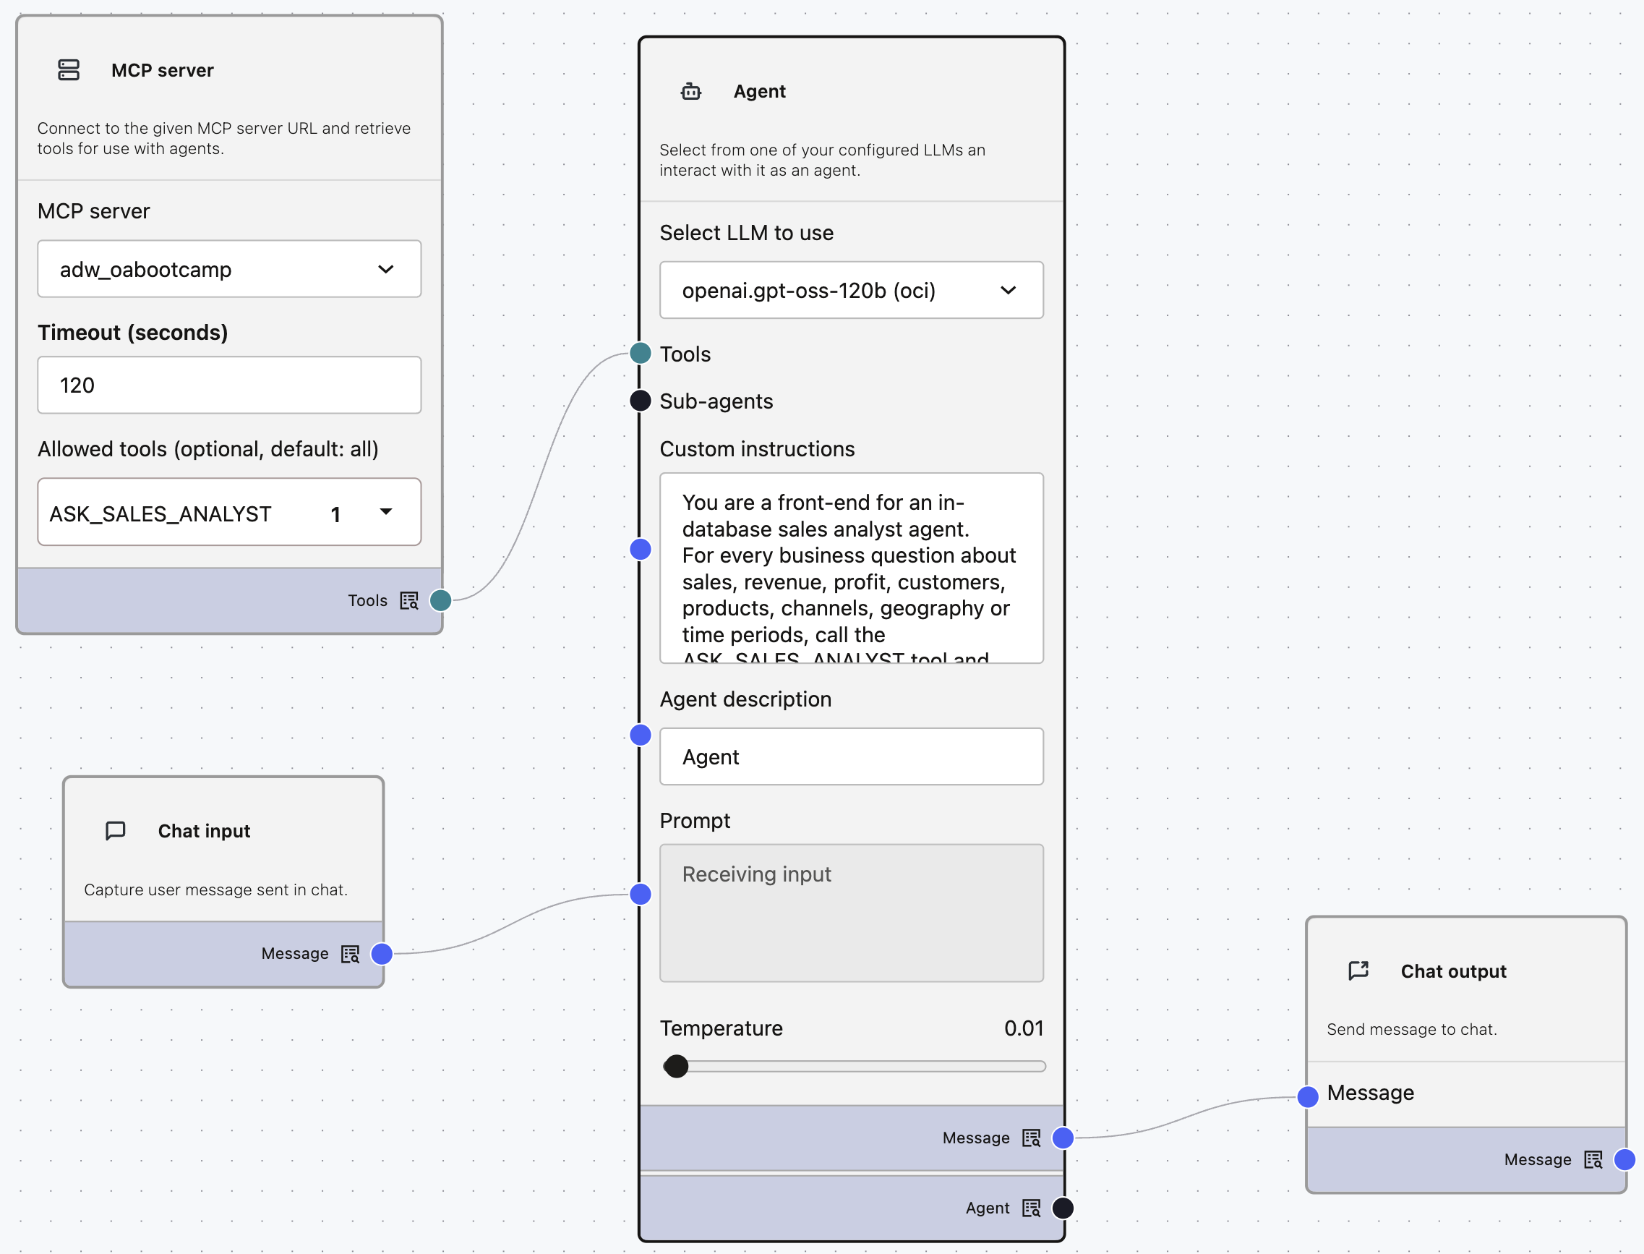
Select AI – MCP Server

Slide 13
Select AI Agenti
4 testna vprašanja in odgovori ter 6 scenarijev
Which sales channel had the highest profit in 2025?
Show me the SQL for profit by channel in 2025
Compare profit in 2025 vs 2024 by sales channel and tell me which channel improved the most
What is the capital of France?
Flow | OPAF building blocks | How OPAF reaches the database | Who plans the analysis
C1 | Select AI node | Database connection (wallet) | Nobody (one question, one SQL statement)
C2 | In-Database Team node, existing team | Database connection (wallet) | Select AI Agent in ADB
C3 | In-Database Tool, Task, Agent and Team nodes, created on the canvas | Database connection (wallet) | Select AI Agent in ADB
A | Agent node + MCP server node (SALES_NL2SQL) | ADB built-in MCP server | OPAF agent
B | Agent node + MCP server node (ASK_SALES_ANALYST) | ADB built-in MCP server | Select AI Agent in ADB
D | Agent node + two Select AI Bridges (Run SQL, Team) | Database connection (wallet) | OPAF agent routes; the in-database team plans analytical questions

Slide 14
Select AI Agenti
Rezultati in primerjava 6 scenarijev
 | C1 | C2 | C3 | A | B | D
Connection | DB | DB | DB | MCP | MCP | DB
LLM in OPAF | none | none | none | plans, calls tools | routes only | routes between bridges
Planning | none (one SQL) | ADB team | ADB team | OPAF agent | ADB team | ADB team for analytical questions
Multi-step | partial (winner only) | full | full | full | full | full
Exact numbers | rounded (Narrate) | yes | yes | yes | yes | yes (team rounds to whole dollars)
Shows SQL | yes (Show SQL) | no | no | yes (showsql) | no | no (declines)
Guardrail | enforce_object_list (raw ORA error) | agent role | agent role | OPAF scope rule | OPAF scope rule | OPAF scope rule

Slide 15
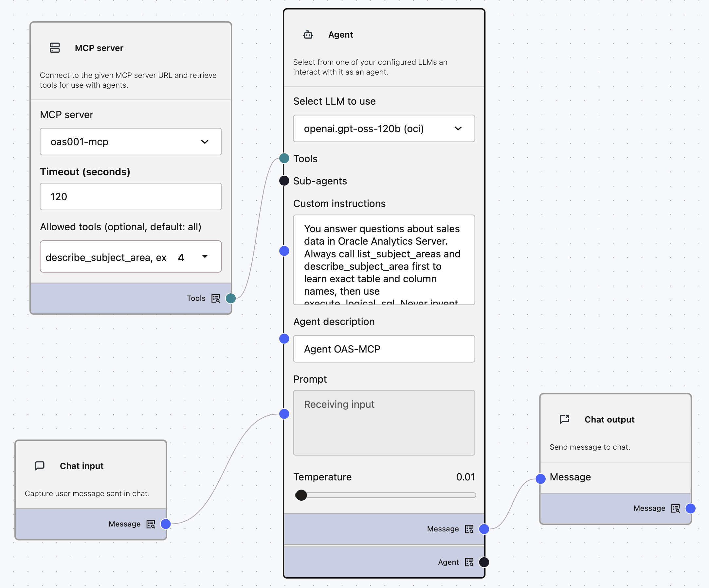
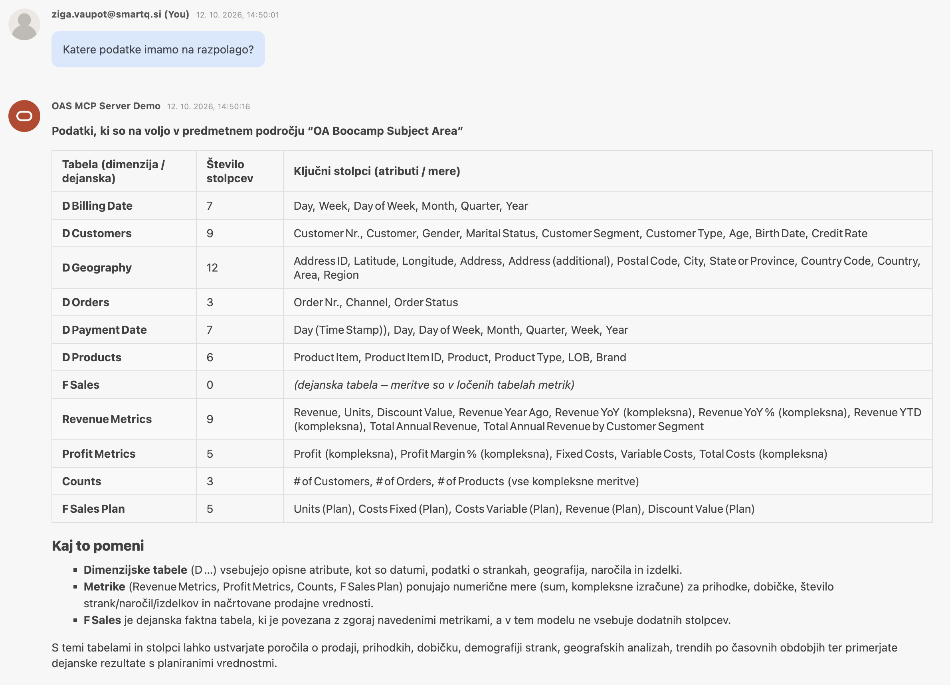
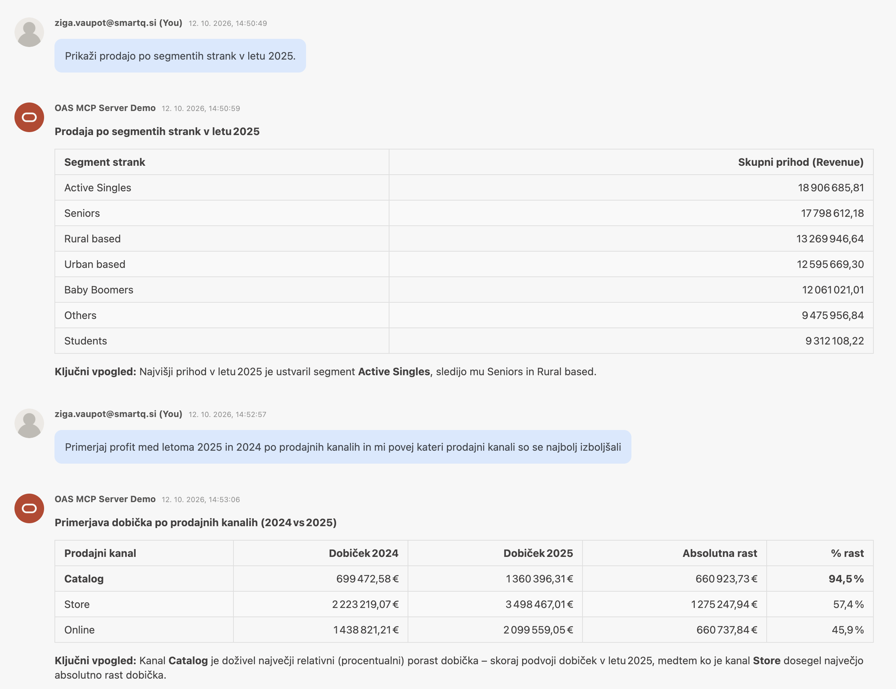
OPAF – OAS MCP Server

Slide 16
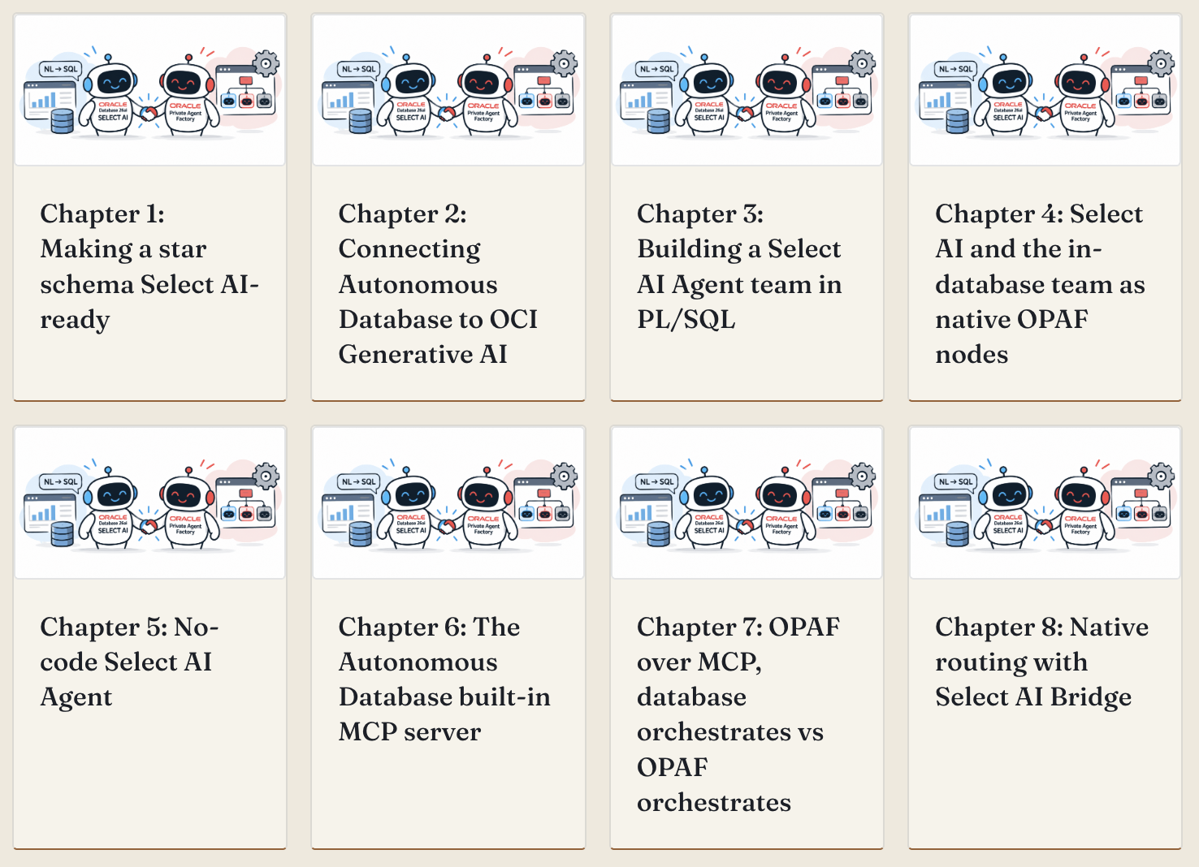
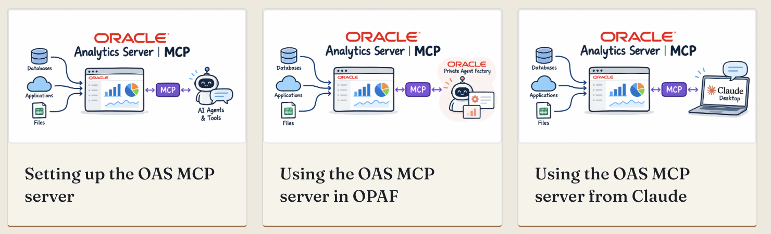
zigavaupot.blogspot.com
https://zigavaupot.blogspot.com/2026/10/oas-mcp-server-and-opaf.html
https://zigavaupot.blogspot.com/2026/10/introduction-to-select-ai-agent-meets.html

Slide 17
R A Z P R A V A

